Slide 1
Status of the RISP facility
ANPhA Symposium
Tohoku University, Sendai
Nov. 24-25, 2016
Kevin Insik Hahn (韓仁植)
Ewha Womans U.
Seoul, Korea

Slide 2
Status of the RISP facility
ANPhA Symposium
Tohoku Univesity, Sendai
Nov. 24-25, 2016
Kevin Insik Hahn (韓仁植)
Ewha Womans U.
Seoul, Korea
Many thanks to Dr. Jeong and other RISP members

Slide 3
Outline
Introduction of the RISP
I.
II.
Current Status of the Projects
III.
RISP Milestones and Schedule
IV.
KOBRA & NAP
V.
Summary
2

Slide 4
Introduction of RISP
Introduction of RISP

Slide 5
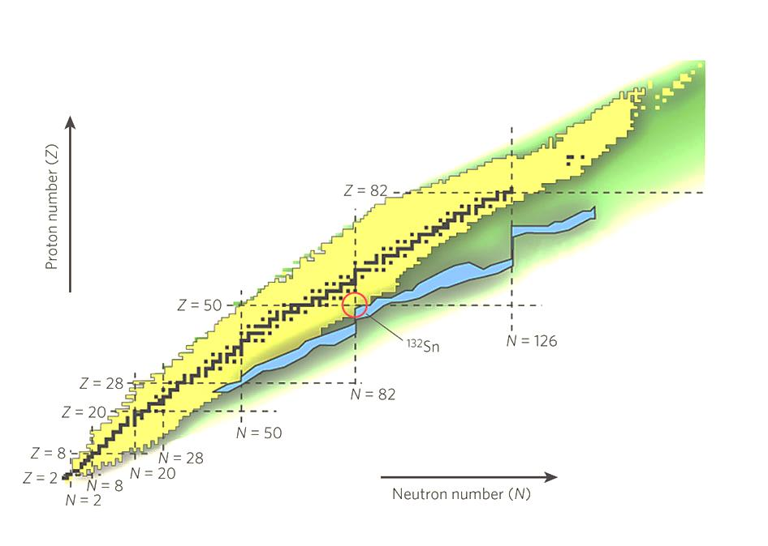
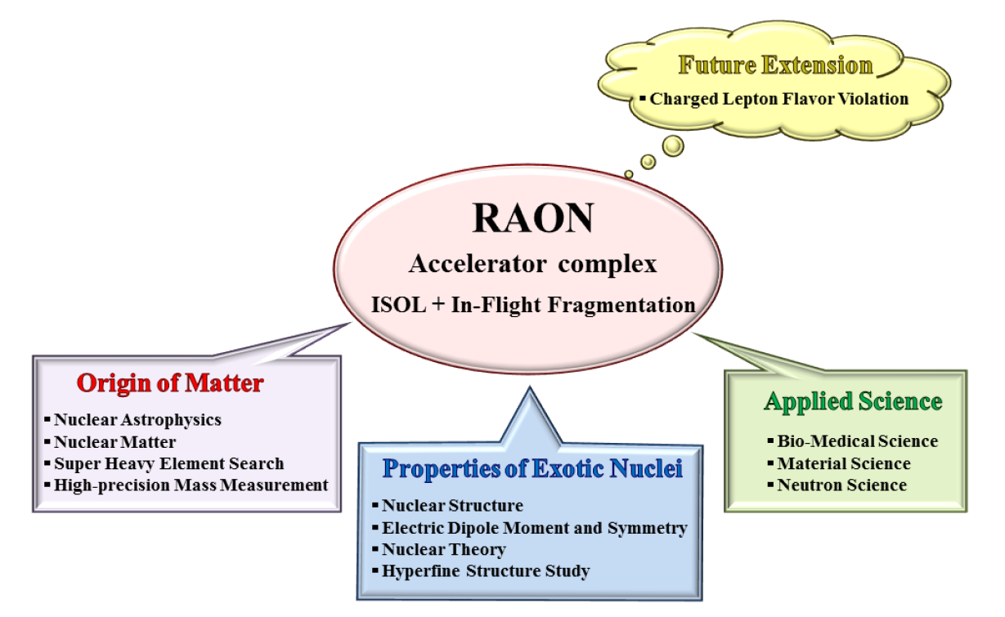
Rare Isotope Science Project (RISP)
Goal: To build a heavy ion accelerator complex RAON,
for rare isotope science research in Korea.
* RAON - Rare isotope Accelerator complex for ON-line experiments
Budget: US$ 1.44 B (1 B$~1T Won)
- accelerators and experimental apparatus : 0.46 B$
- civil engineering & conventional facilities : 0.98 B$ (incl. construction site purchase)
(recently approved in June 2014)
Period: 2011.12 ~ 2021.12 (10.1 years)

Slide 6
RISP Organization with Advisories
Ministry of Science,
ICT and Future Planning (MSIP)
Project Promotion Committee
Institute for Basic Science
(IBS)
National Research Foundation
Rare Isotope Science Project
Director
Int. Adv. Committ.
Tech. Adv. Committ.
Research Center(s)
for Rare Isotope Science
Sci. & Prog. Adv. Committ.
Civil Engi. Adv. Committ.
System Installation
Division
Facility Construction &
Infrastructure Division
Project Integration
Division
Administration
Division
Project Collaboration
Division
RI Beam
production Sys.
Facility & Safety
Managemnt Team
Project
Coordination
Project
Management
Research
Management
Research
Collaboration
Information &
Collaboration
Accelerator Sys.
Accelerator Eng.
Construction
Managnement
Human Resource &
General Affair
Planning & Budget
Experiemntal Sys.
9

Slide 7
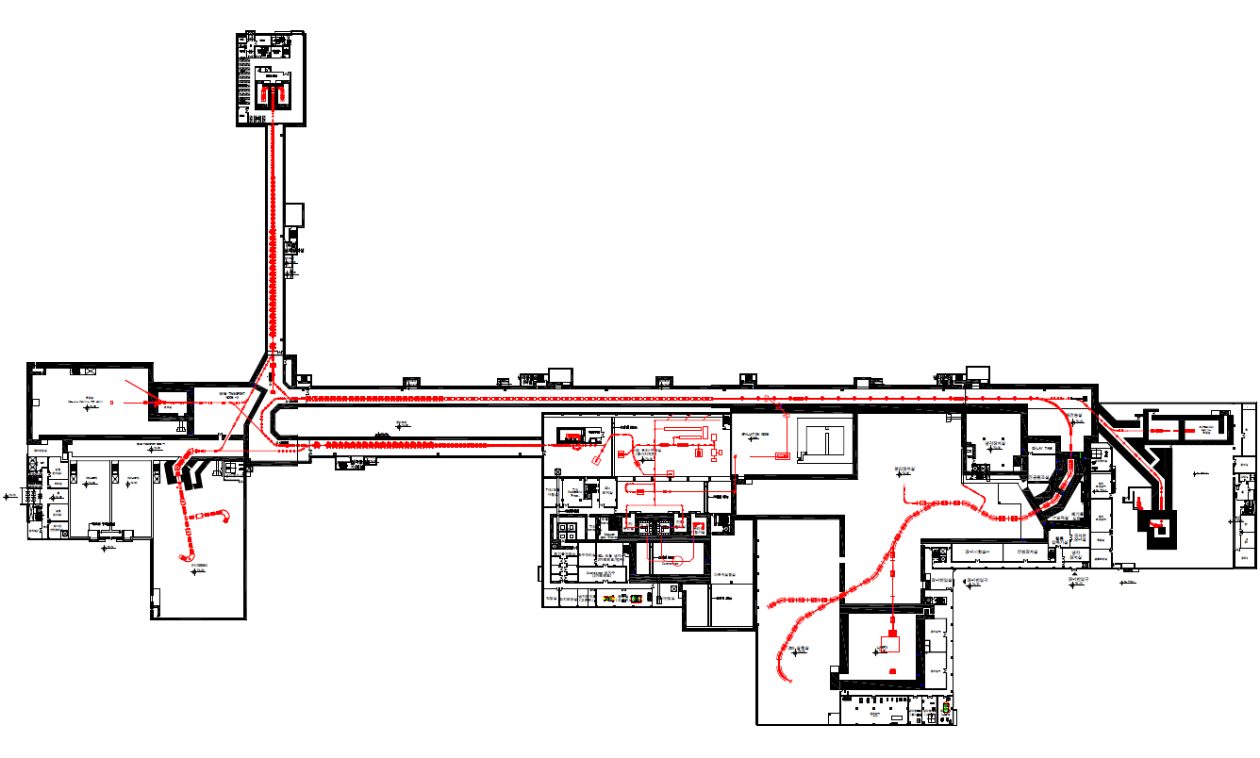
RAON Concept
: Accelerator complex for producing rare isotope beams
High intensity RI beams by ISOL & IF
ISOL : direct fission of ²³⁸U by a 70MeV-proton cyclotron ~ 10¹⁴ f/s
IF by 200MeV/u, 8.3pμA ²³⁸U by a 400kW-superconducting LINAC
High quality neutron-rich RI beams
¹³²Sn with up to ~250MeV/u, up to ~10⁸ pps
More exotic RI beams by ISOL+IF
Injector
SCL1
NDPS
BIS &
muSR
SCL2
HPMMS
& CLS
SCL3
Cyclotron
IF (high E)
KOBRA
ISOL
LAMPS

Slide 8
Lineup of RIB production & separation
ISOL→IF
SCL1
: ISOL→SCL3→SCL2→IF
SCL2
: ISOL→SCL3→KOBRA
SCL3
IF→Re-Acc
(future upgrade)
: IF→stopped beam→SCL
U-18.5MeV/u
70MeV-p
U-200MeV/u
KOBRA (low E IF)
ISOL
IF (high E)
Driver
SCL3 or SCL1
Cyclotron
SCL3→2 or SCL1→2
Post Acc
SCL3 or SCL3→2
Production mechanism
Direct reactions
- (p,d), (³He,n) etc
, MNT
p induced U fission
PF, U fission
Available RIB energy
< a tens of MeV/u
> a few of keV/u
< a hundreds of MeV/u
8

Slide 9
Expected RIBs at RAON in nuclear landscape
Stable ~300
Known ~2700
Unknown ~7000
IF
ISOL
KOBRA
ISOL+IF
RAON will provide access to unexplored regions of the nuclear chart !
RAON will be a powerful RIBs’ supplier to users globally
→ More exotic, More intense, and More various RIBs
9

Slide 10
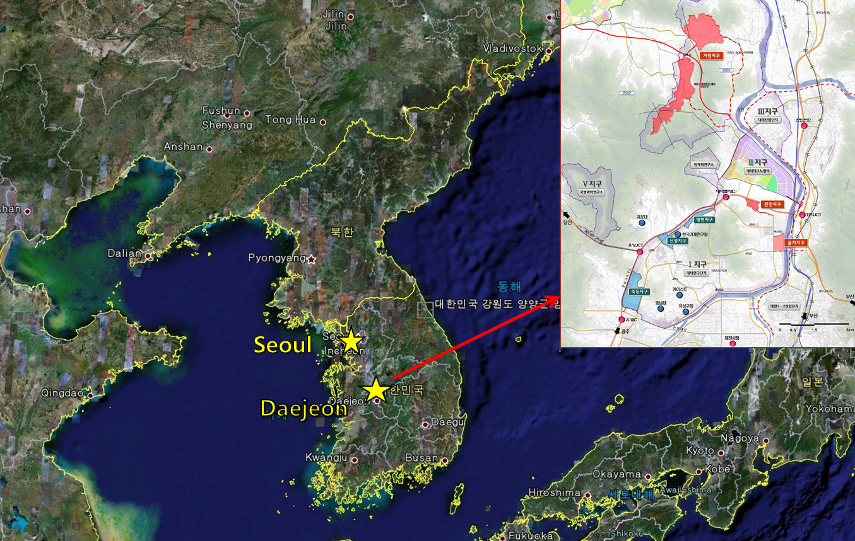
RAON Site :
Sindong in Daejeon
~11 km
Current RISP Office
~160km

Slide 11
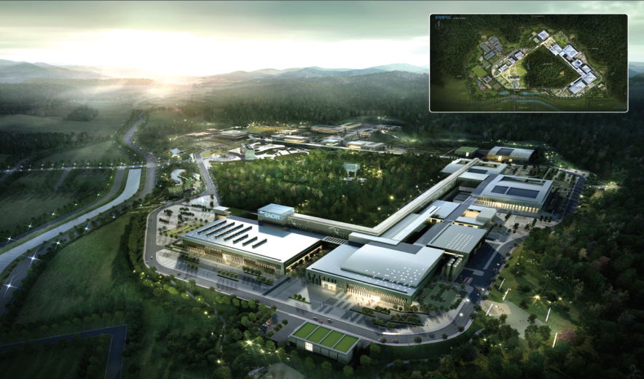
Bird’s eye view of the RISP Facility
Bird’s-eye view
Basic design was finished in Dec. 2015
A construction company was selected in Sept. 6, 2016. i
Area (Lot/Bldg): 952,066 m² / 130,257 m²
5

Slide 12
Facility Overview
RAON Overview
2

Slide 13
Layout of RAON
Injector1
SCL1
NDPS
BIS &
muSR
SCL2
Injector3
SCL3
HPMMS
& CLS
Cyclotron
IF (high E)
KOBRA
ISOL
1순위: Cyclotron, ISOL, SCL3, KOBRA, MMS, CLS
2순위: SCL2, IF, LAMPS
LAMPS
3순위: SCL1, NDPS, MSF, BIS

Slide 14
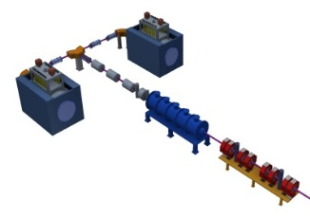
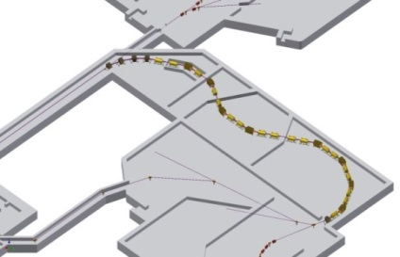
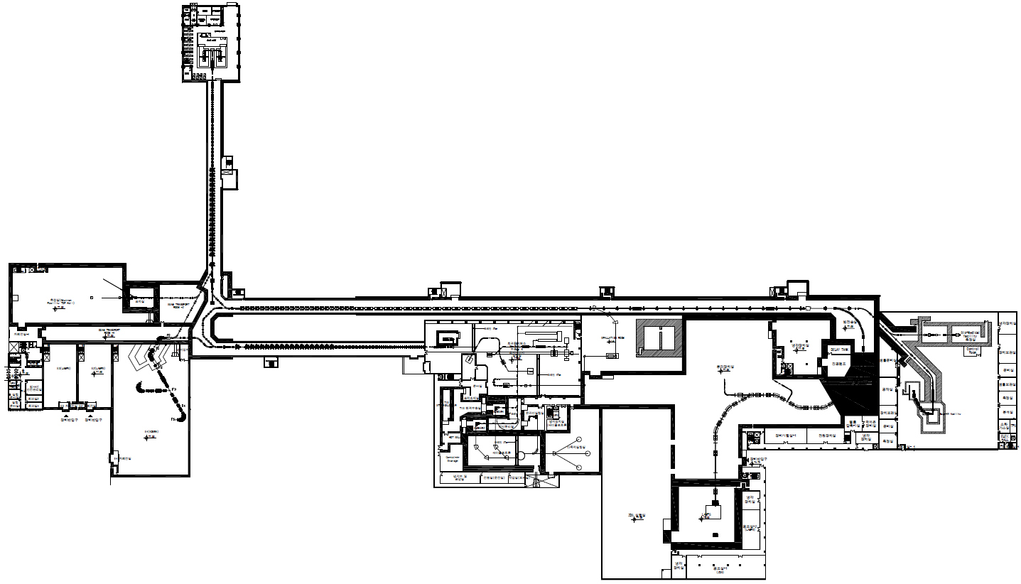
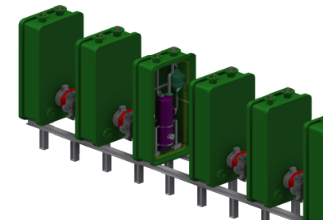
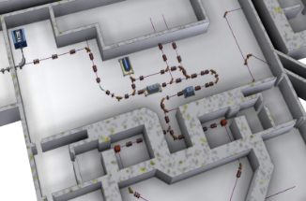
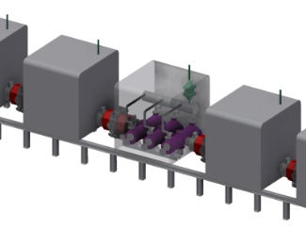
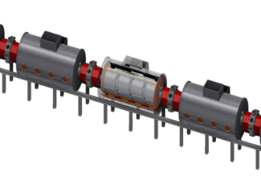
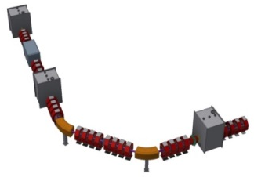
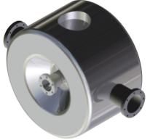
Accelerator systems (Layout & Specs.)
28-GHz ECRIS
(A/q<7 10keV/u)
81.25MHz 4-vane RFQ
(500keV/u)
10Tm
F8
IF SYSTEM
Injector
Parameters of superconducting linacs
β=0.047
81.25Hz
Note | SCL1 / SCL3 |  |  | SCL2
Cavity | QWR | HWR |  | SSR1 | SSR2
Frequency (MHz) | 81.25 | 162.5 |  | 325 | 325
Qo(xE9) | 1.83 | 4.05 |  | 9.2 | 10.5
Ep (MV/m) | 35 | 35 |  | 35 | 35
T (K) | 4.5 | 2 |  | 2 | 2
No. of cavity in CM | 1 | 2 | 4 | 3 | 6
No of CMs | 22 | 14 | 19 | 23 | 23
E_{out} (MeV/u) for U (A/q ~7) / p | 2.7 | 6.0 | 18.5 / 88 | 56.5 | 200 /600
1/22
ISOL SYSTEM
RILIS/SI
EBIS
MR-TOF
(2.7MeV/u)
SCL1(QWR)
β=0.12
162.5MHz
70-MeV H⁻ cyclotron
~10¹⁴ fis/s
Cyclotron
2/14
4/19
(18.5MeV/u)
SCL1(HWR)
Charge Stripper
Liq. Li
20μm
β=0.3, 0.51
325MHz
3/1/23
6/1/23
A/q
~7➔~3
(200MeV/u)
SCL2 (SSR)
Warm sections for focusing components betw. CMs

Slide 15
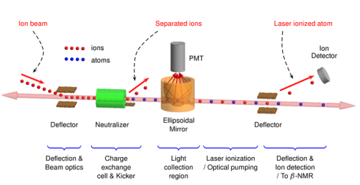
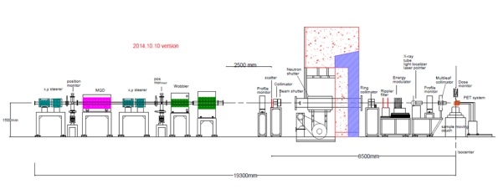
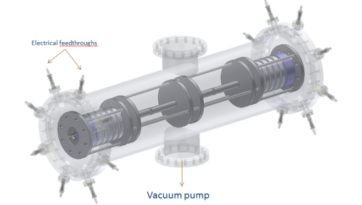
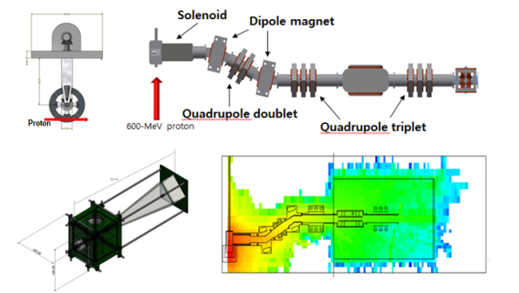
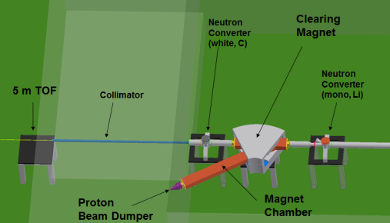
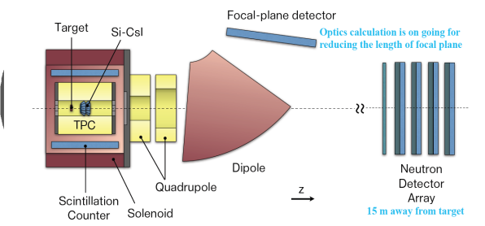
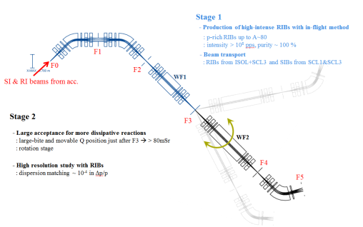
Experimental Systems
HI >200MeV/u
CLS
Bio-medical facility
High Energy Exp. II
P-600MeV
HPMMS
μSR
~keV/u
Very-low Energy Exp.
High Energy Exp. I
p, d, Li <P-88MeV/u
Neutron Facility
> U-200 MeV/u
LAMPS
> U-18.5MeV/u
KOBRA
Low Energy Exp.

Slide 16
Project Status
Project Status

Slide 17
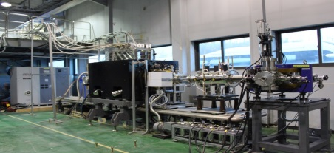
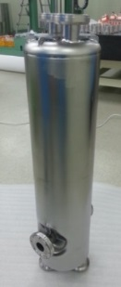
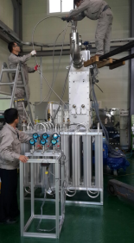
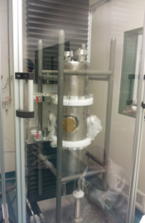
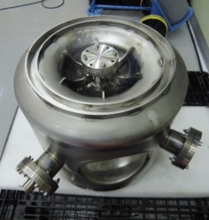
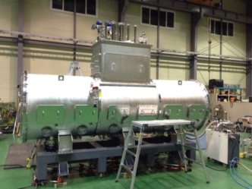
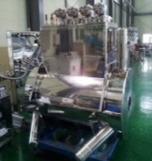
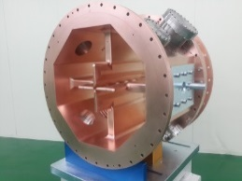
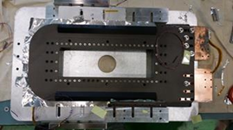
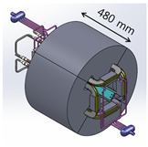
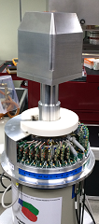
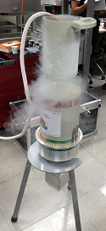
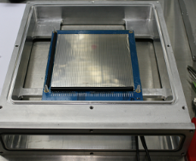
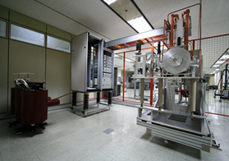
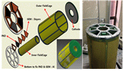
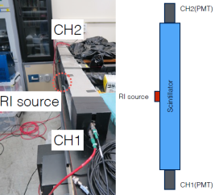
Prototyping & test… under progress
Injector System
SC LINAC System
QWR
HWR
SSR
QWR
28GHz
ECR-IS
IF System
RFQ
Low-energy Exp. System
ISOL System
High-energy Exp. System

Slide 18
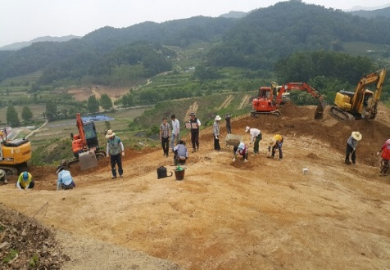
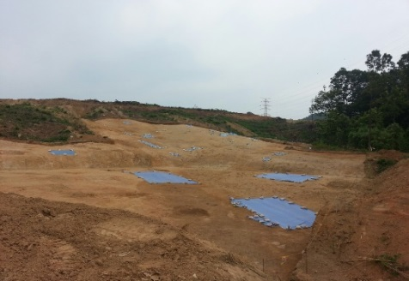
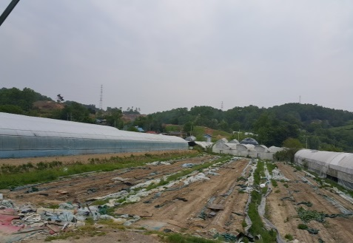
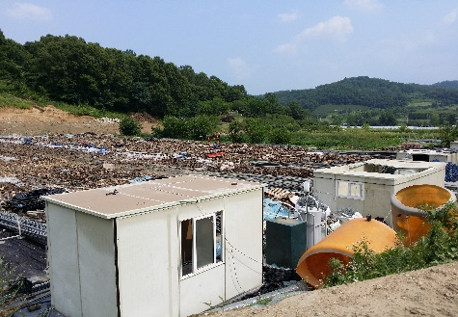
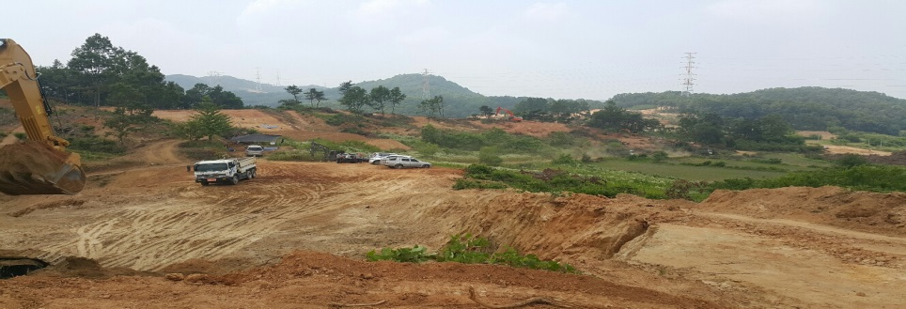
Construction & Civil Eng.
Status of Site (Cultural assets & Site preparation)
Sales contract
(`14.12.26.)
Land compensation
(`15.10.01.)
Expropriation decision
(`16.06.14.)
Site preparation
(`16.06.15.)
Excavation of cultural assets
Acc. & Exp. bldg site('15.12.~'16.09.), Support bldg site('16.06.~'16.11.)
Site preparation :
Acc. & Exp. bldg site ('16.07.~'17.01.), Support bldg site('16.08.~'17.06.)

Slide 19
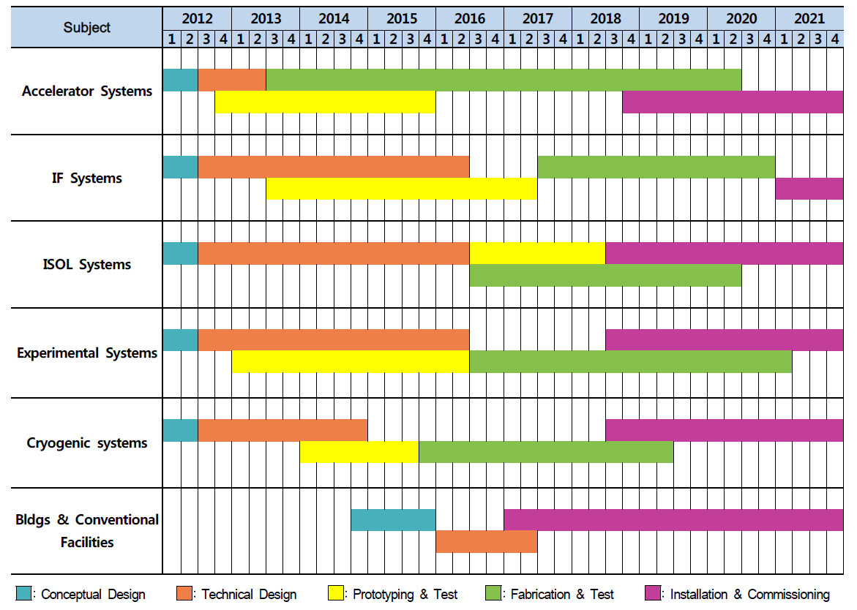
RISP Milestone Schedule
ECR SI Beam
RFQ Beam
SCL Demo Beam
SCL SI Beam
IF RI Beam
ISOL SI Beam
Cyclotron
ISOL RI Beam
DAY-1 Experiment
Start Utility Supply
Begin Construction
Completion

Slide 20
Project Status
Demonstration system
@ off-site test facility

Slide 21
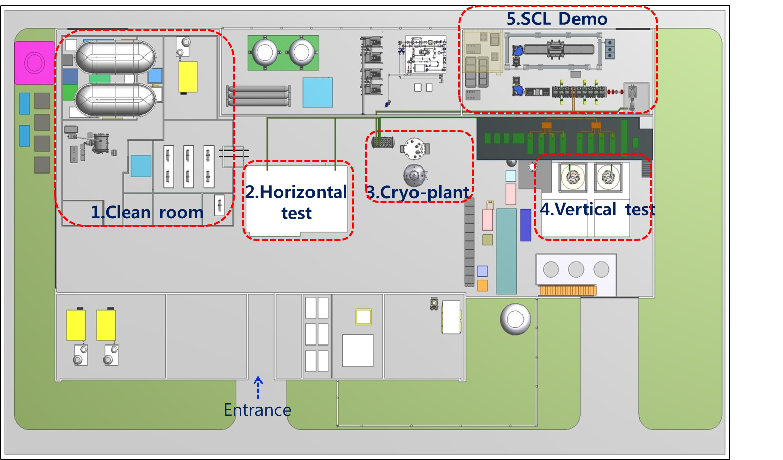
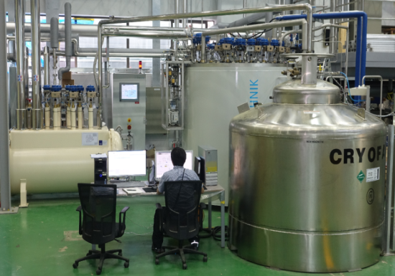
SRF Test Infrastructure (off-site test facility)
Performance test of SC cavities and cryomodules
Quality control of SC cavities and CMs delivered by vendors in mass production
Test schedule in 2016
up to class 10
Start operating
from June, 2016.
Cold Box
DB
Vertical cavity test
Dewar
Cryomodule test
LHe system (330 W at 4.5 K)

Slide 22
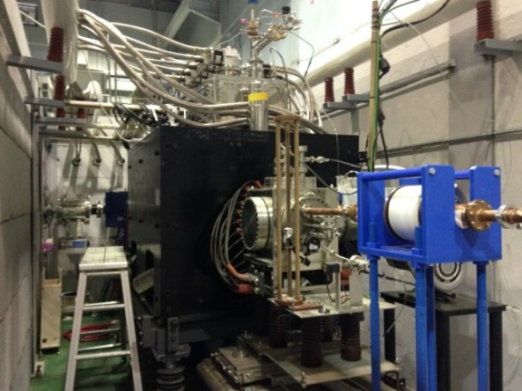
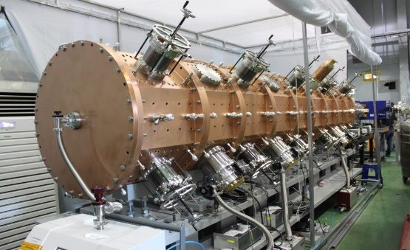
Demonstration System
For integral test of key accelerator systems
Sub-systems to be installed by the end of 2016
- ECR-IS, LEBT, RFQ, MEBT, QWR
- Aux systems: Cryogenic system,RF system,
Beam diagnostics, Beam dump, etc.
28GHz SC ECRIS
A/q~7, 10keV/u
82.25MHz QWR
500keV/u➔ 530KeV/u
82.25MHz 100kW RFQ
10keV/u➔500keV/u

Slide 23
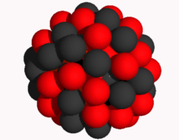
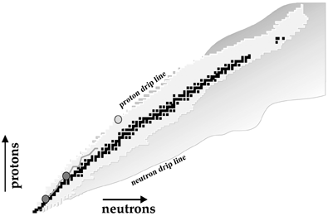
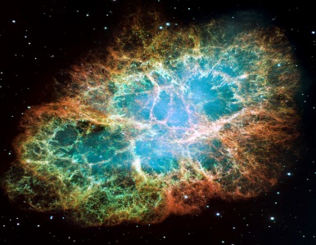
Rare Isotope Science
Nuclear Physics
- Structure of exotic nuclei
- Properties of exotic nuclei: masses, radii, life-time etc
- Search for super heavy elements
- Nuclear theory: nuclear force, nuclear model
Nuclear astrophysics
- Stellar evolution
- Nucleosynthetic processes under stellar environments
- EoS of asymmetric nuclear matter such as neutron stars
Applications
- Bio-medicine
- Material sciences
- National security

Slide 24
RAON Layout: Experimental system
HPMMS
CLS
Neutron Facility
Bio-medical facility
Low Energy Exp. Bldg
Ultra-low Exp. Bldg
High Energy Exp. Bldg
μSR
KOBRA
LAMPS

Slide 25
Experimental Facilities at RAON
Field | Facility | Exp. hall | Characteristics | Remark
Pure science | Recoil spectrometer – KOBRA | Low E | High resolution, Large acceptance function, RIBs production with in-flight method | Mass resolution; ~ 200 Large acceptance; ~ 80 msr
 | Large acceptance Spectrometer – LAMPS(L&H) | Low & High E (I) | High efficiency for charged particle, n, and γ | TPC ; 3π sr, Neutron wall, Si-CsI array, dipole spectrometer
 | High resolution Spectrometer | High E (I) | High resolution, Precise scattering Measurement to the focal plan, Rotatable | Momentum resolution ; 1.5x10⁴
 | Zero-degree Spectrometer | High E (I) | Charge and mass separation, Good mass resolution | Momentum resolution ; 1200~ 4100
 | High precession mass measurement system | Ultra low E | Penning trap, Multi-reflection Time of flight | Mass resolution ; 10⁻⁵~ 10⁻⁸
 | Collinear laser Spectroscopy | Ultra low E | High Resolution Laser Spectroscopy System | Spectral resolution ; ≤ 100 MHz
Applied science | β-NMR/μ-SR | Low / High E (II) | High intensity ⁸Li & muon production | ⁸Li & muon > 10⁸ pps
 | Bio-medical facility | Low & High E (II) | Irradiation system for stable & radio ion beam | Uniformity ; < 5%
 | Neutron science Facility | Low E | Fast neutron generation & measurement system of fission cross section | Uncertainty ; < a few %
(KOrea Broad acceptance Recoil spectrometer and Apparatus)

Slide 26
Characteristics of the KOBRA
Versatile two-stage device
RI beams production (stage1)
- low energy in-flight method
- Quasi Projectile Fragmentation
- Polarized RI beam (beam swinger)
High performance spectrometer (stage2)
Commissioning
in 2019 !
- Rotatable
- Large acceptance (>50mSr) by movable Q magnets just after F3
- High momentum resolution (p/Δp ~ 10,000) by dispersion matching

Slide 27
Beam Production (⁴⁴Ti)
⁴²Ca(³He, n)⁴⁴Ti @ E = 5.77 MeV/u
E (⁴²Ca) = 5.77 MeV/u ± 0.1%,
beam size = ± 1 mm,
Δθ = ± 5 mrad,
³He target thickness : 2.4 mg/cm²
F0
D1
F1
D2
F2
Wien Filter 1
F3
⁴²Ca ²⁰⁺
All with Z-Q = 0
⁴⁴Ti ²²⁺
⁴⁴Ti
⁴⁴Sc
⁴⁴Sc ²¹⁺
⁴³Sc ²¹⁺
⁴³Sc
@ F1
Q = Z, Z-1, Z-2, Z-3, Z-4

Slide 28
Case study 1: Direct measurement of ¹⁵O(α,γ)¹⁹Ne
Motivation
- ¹⁵O(α,γ)¹⁹Ne reaction
: breakout path from hot-CNO to rp-process
: key reaction to understand nucleosynthesis under explosive stellar environments
Experimental Challenges
- For direct measurement of cross section we need
: ¹⁵O RI beam intensity > 10¹⁰pps , Helium-4 target density > 10¹⁸ atoms/cm²,
recoil detection efficiency > 40% → then ~1 counts/hr
Simulation to check the performance of KOBRA

Slide 29
Case study 2: Production of ²⁴O
Motivation
- ²⁴O
: the most n-rich of bound Oxygen isotopes
- RIBs’ production capability of KOBRA,
especially RIBs near p- or n-drip line needs
to be checked
: comparison with other facilities
Simulation to check the performance of KOBRA

Slide 30
Cyclotron+ISOL+SCL3 for LE-Exp.
SIB @ 2020
RIB @ 2021
Uniqueness
in terms of beam energy
(SIB, RIB)
➔Variable
from ~500keV/u
to U-18.5MeV/u
& p-88MeV/u
CLS
High Energy Exp. II
HPMMS
~keV/u
Very-low Energy Exp.
High Energy Exp. I
p, d, Li <P-88MeV/u
Neutron Facility
ISOL
Injector3
Cyclotron
SCL3
> U-18.5MeV/u
Conventional
low-energy
scattering experiments
with high precision
using
RIB & SIB
KOBRA
Low Energy Exp.

Slide 31
Science at LAMPS
LAMPS will provide experimental data using rare isotope beam
e.g. ¹³²Sn + ¹²⁴Sn
→ measure n/p ratio & proton/neutron flow at same time
Experimental data are measured with stable beams
Data of pion ratio and data of n/p flow are from different experiments
Models in the market show different results even within same observable

Slide 32
RIB energy vs. Intensity
@ LE Halls
by KOBRA
@ VLE hall
By HPMMS & CLS

Slide 33
Summary (1)… (As project development)
Development of accelerator and experimental systems of the RISP is on track with civil constructions
Prototyping of major accelerator parts has been in progress since 2013 (after TDR)
Some prototypes are in testing stage.
SRF test facility is operating from June 2016.
Under progress for the procurement of cavities, cryomodules etc… of SCL3 in 2016.4Q (for mass- production) ➔Vendor(s) for SCL3 will be selected in 2016

Slide 34
Summary (2)… scientific opportunity
RAON- Rare isotope Accelerator complex for ON-line experiments
Stable and Rare Isotope HI beams (accelerated properly) can open a new era in Korea for the research of basic science.
Strong connections to applications and training
Early operation of Low-Energy Facility from the end of 2019
Efforts on collaboration:
-IBS research centers, international and domestic users communities
Call for LoIs in 2016, especially for low-energy facility
-Welcome suggestion for new instruments: space available in
experimental halls

Slide 35
Summary (3)… nuclear astrophysics
Korea will build the RI beam accelerator facility, called RAON. Integration of ISOL and IF is one of the distinct features of RAON.
Experimental systems such as KOBRA for nuclear astrophysics and nuclear structure experiments are being developed in parallel.
There will be a lot of opportunities for nuclear astrophysics experiments in Korea. We welcome your collaboration!

Slide 36
Thank You
The 14th International Symposium on Origin of Matter and Evolution of Galaxies (OMEG)
June 27-30, 2017
hosted by RISP

Slide 37
Rare isotope Accelerator complex for ON-line experiments
Thank for your attention.

Slide 38
RISP Milestone Schedule
ECR SI Beam
RFQ Beam
SCL Demo Beam
SCL SI Beam
IF RI Beam
ISOL SI Beam
Cyclotron
ISOL RI Beam
DAY-1 Experiment
Start Utility Supply
Begin Construction
Completion

Slide 39
Case study 1: Direct measurement of ¹⁵O(α,γ)¹⁹Ne
Motivation
- ¹⁵O(α,γ)¹⁹Ne reaction
: breakout path from hot-CNO to rp-process
: key reaction to understand nucleosynthesis under explosive stellar environments
Experimental Challenges
- For direct measurement of cross section we need
: ¹⁵O RI beam intensity > 10¹⁰pps , Helium-4 target density > 10¹⁸ atoms/cm²,
recoil detection efficiency > 40% → then ~1 counts/hr
Simulation to check the performance of KOBRA

Slide 40
Case study 2: Production of ²⁴O
Motivation
- ²⁴O
: the most n-rich of bound Oxygen isotopes
- RIBs’ production capability of KOBRA,
especially RIBs near p- or n-drip line needs
to be checked
: comparison with other facilities
Simulation to check the performance of KOBRA

Slide 41
OEDO
From OEDO project S. Shimoura
LoI for RIBF PAC June 2014

