Slide 1
Status of Nuclear Physics in Korea
The 8th Asian Nuclear Physics Association Symposium
(ANPhA 2016)
Tohoku University, Sendai, Japan, 24-25 November, 2016
Byungsik Hong
(Korea University)

Slide 2
Division of Nuclear Physics in the Korean Physical Society
Chair
B. Hong
Secretary
E. J. Kim
HIM
C. H. Hyun
M. J. Kweon
HaPhy
S. H. Choi
Y. Oh
J. K. Ahn
LENS
K. Chae
K. S. Choi
Y. Kim
ANPhA Committee
K. I. Hahn, B. Hong, M. K. Cheoun
Applications
K. Cho
H. S. Park
International Relations
Y. K. Kwon
H. J. Lee
HIM: Relativistic Heavy-Ion Collisions
HaPhy: Hadron Physics
LENS: Low-Energy Nuclear Science
Executive Committee

Slide 3
Korean Nuclear Physics Community in Numbers
Total # of active professors in Universities: 44
  Experimentalists : Theorists = 19 : 25
  Male : Female = 39 : 5
  National Univ. : Private Univ. = 17 : 27
Research staffs with permanent appointment in Laboratories: >20 (No exact statistics)
Non-permanent staffs (including postdocs) + Students : No statistics

Slide 4
Experimental Status of HIM
Subject | Accelerator | Experiment | Participating institutes
HIM (QGP) | LHC | ALICE | Inha, Pusan, Sejong, Yonsei
 |  | CMS | Korea, Chonnam Nat.
 | RHIC | PHENIX | Chonbuk Nat., Ewha Womans, Hanyang, Korea, Myongji, Seoul Nat., Yonsei
 |  | STAR | Pusan Nat.

Slide 5
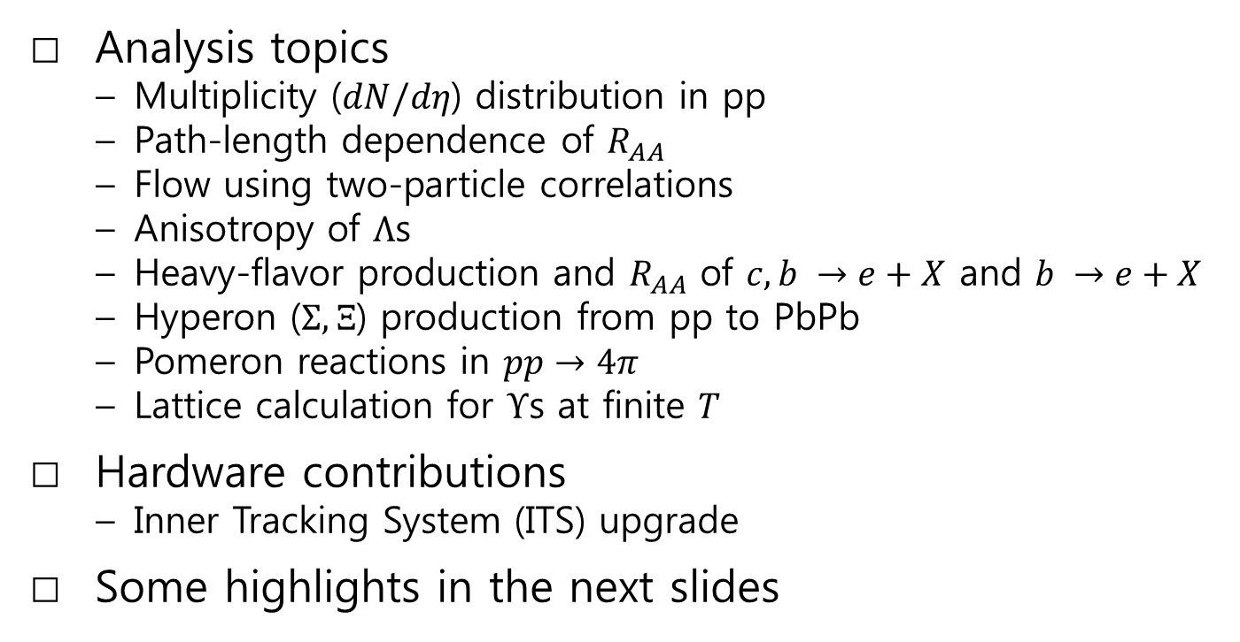
Korea in ALICE
Analysis topics
  Multiplicity ($dN/dη$) distribution in pp
  Path-length dependence of $R_{AA}$
  Flow using two-particle correlations
  Anisotropy of $Λ$s
  Heavy-flavor production and $R_{AA}$ of $c, b →e+X$ and $b →e+X$
  Hyperon ($Σ, Ξ$) production from pp to PbPb
  Pomeron reactions in $pp→4π$
  Lattice calculation for $Υ$s at finite $T$
Hardware contributions
  Inner Tracking System (ITS) upgrade
Some highlights in the next slides

Slide 6
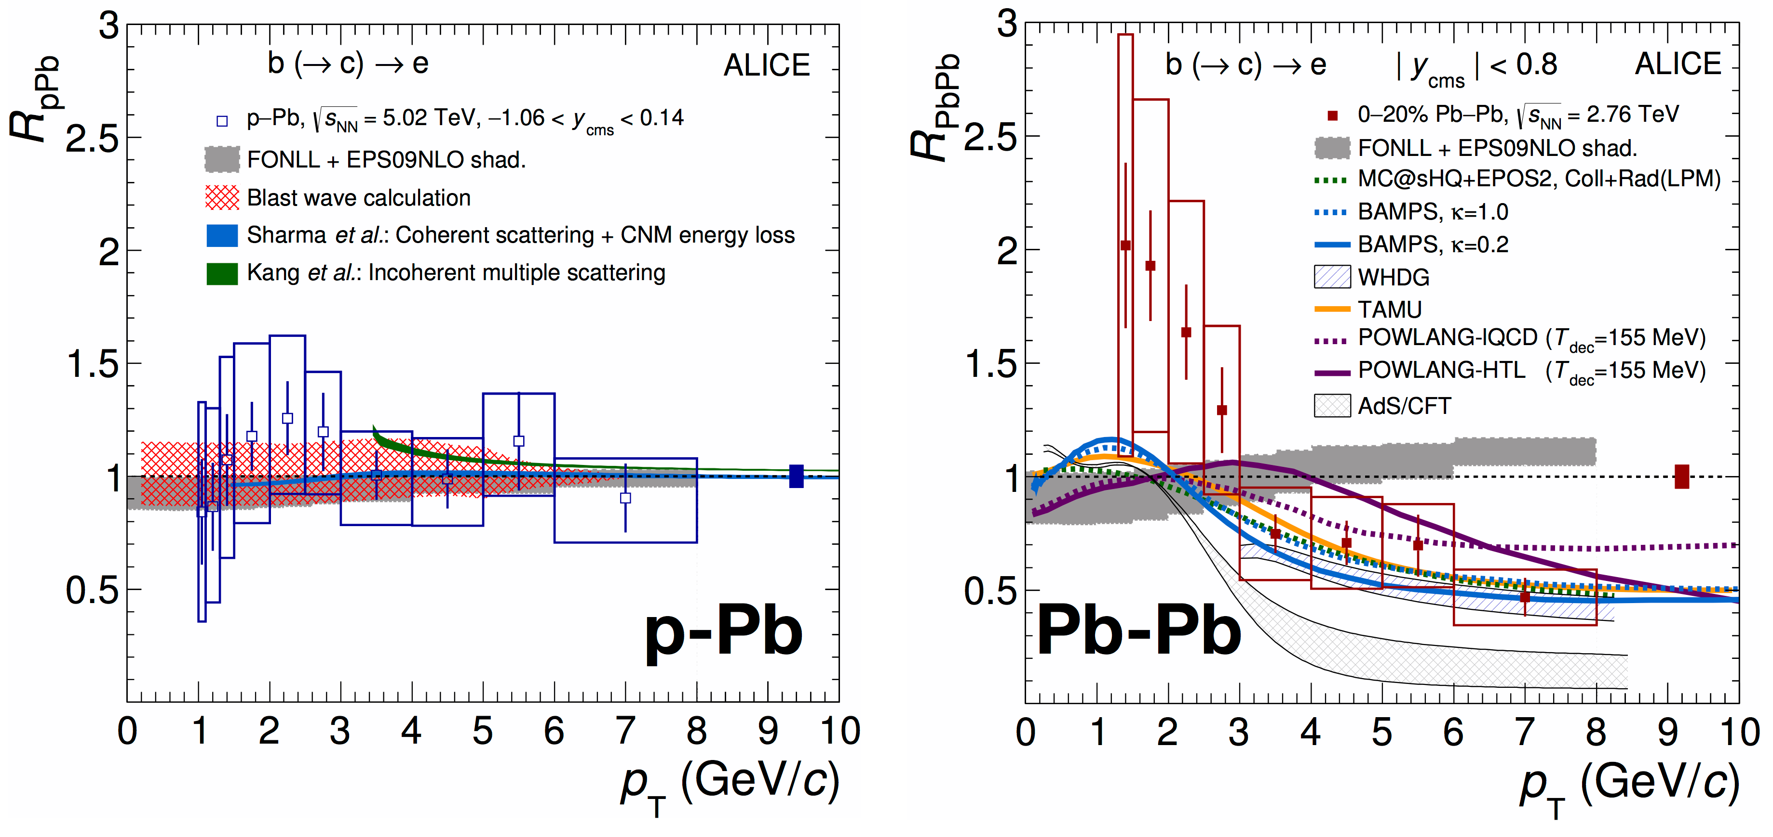
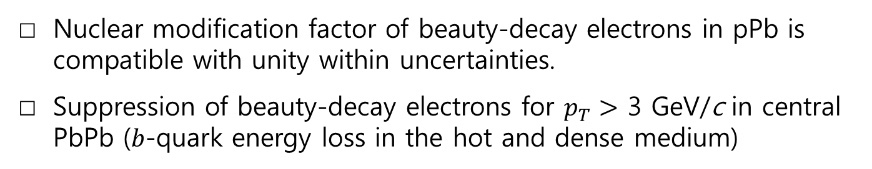

$R_{AA}$ of $b→e$
Submitted to JHEP
arXiv:1609.03898
koALICE member is one of the paper committee members.
Nuclear modification factor of beauty-decay electrons in pPb is compatible with unity within uncertainties.
Suppression of beauty-decay electrons for $p_{T}>$ 3 GeV/c in central PbPb ($b$-quark energy loss in the hot and dense medium)

Slide 7
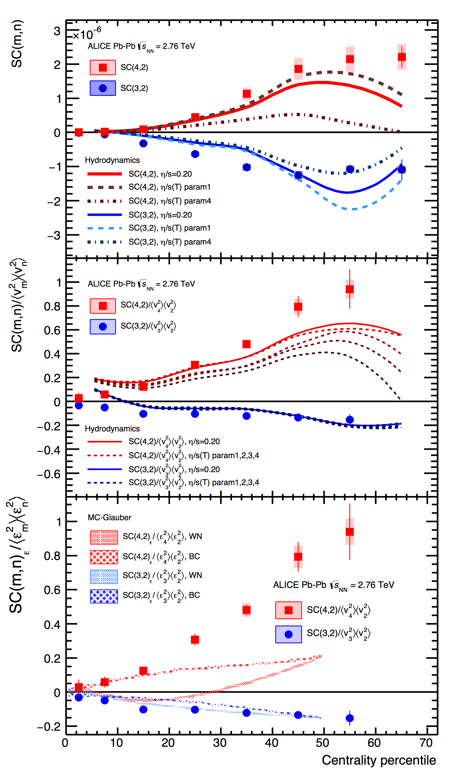
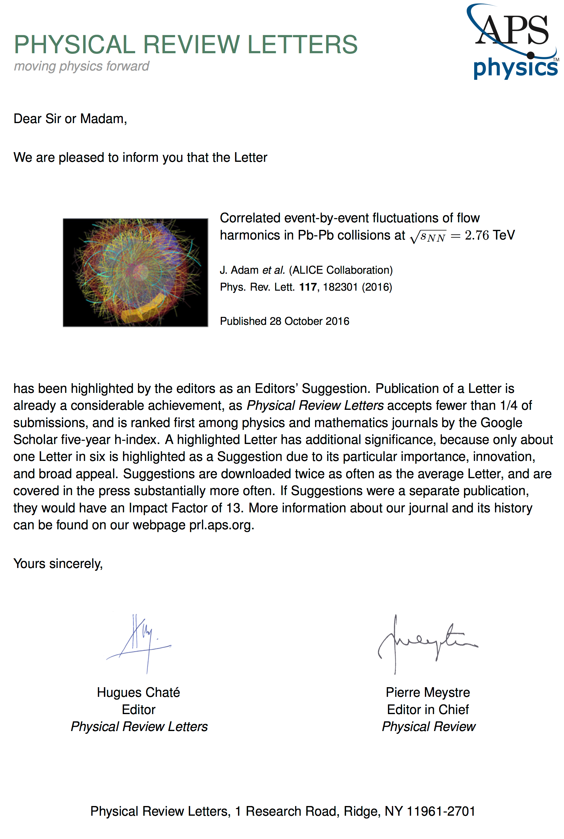
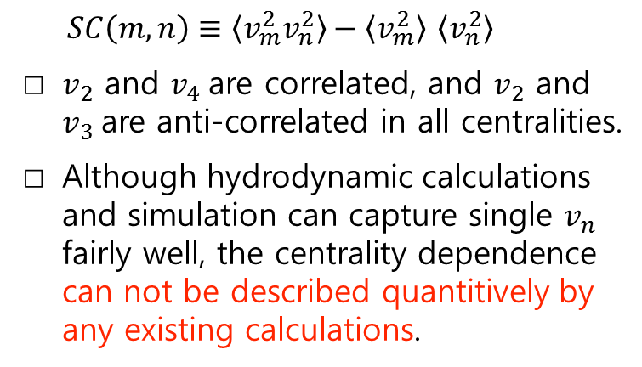
Correlated event-by-event fluctuations of flow harmonics
PRL 117, 182301 (2016)
$SC\left(m,n\right)≡\left\langle v_{m}^{2}v_{n}^{2}\right\rangle −\left\langle v_{m}^{2}\right\rangle$ $\left\langle v_{n}^{2}\right\rangle$
$v_{2}$ and $v_{4}$ are correlated, and $v_{2}$ and $v_{3}$ are anti-correlated in all centralities.
Although hydrodynamic calculations and simulation can capture single $v_{n}$ fairly well, the centrality dependence can not be described quantitively by any existing calculations.
Highlighted as an Editors’ suggestion in PRL!

Slide 8
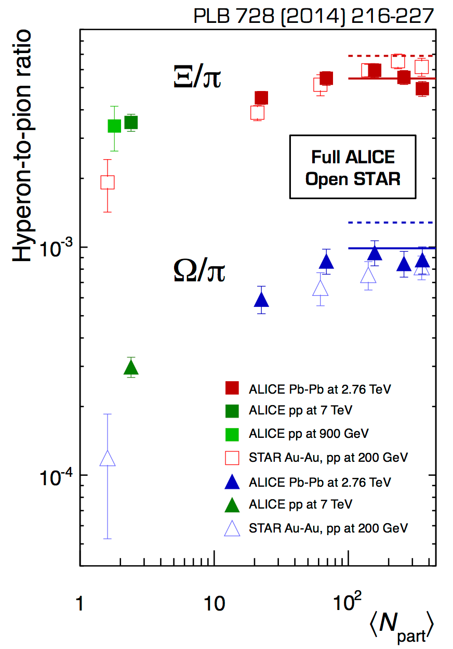
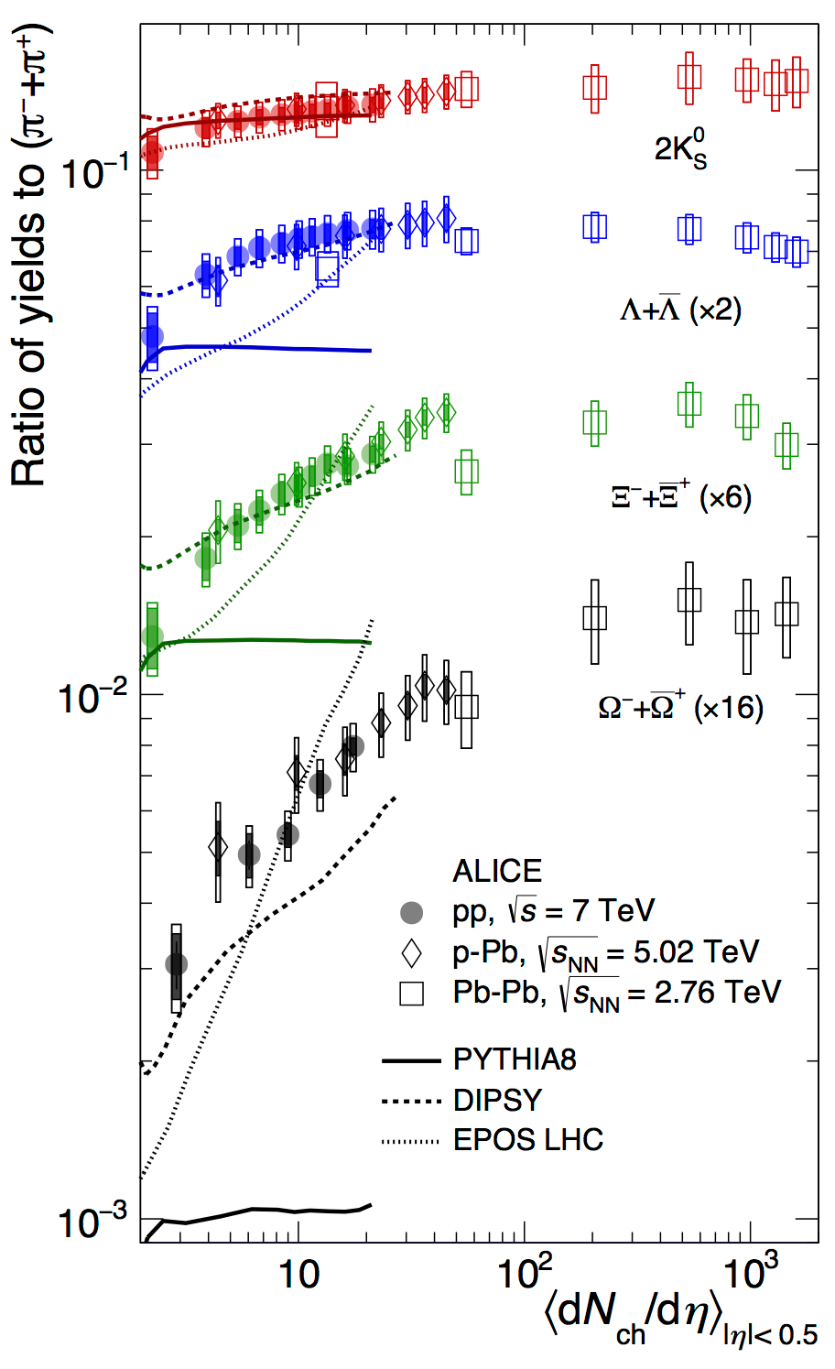
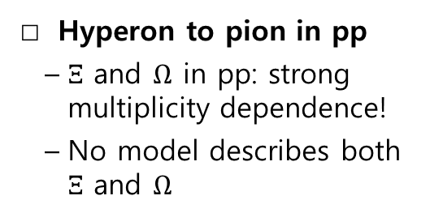
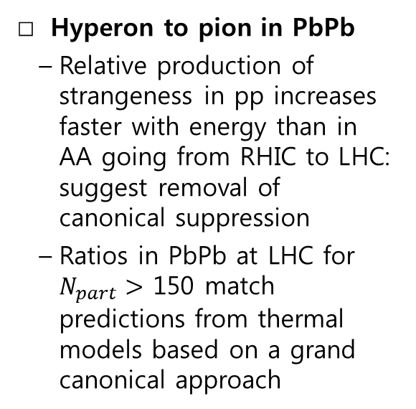
Strangeness Production
arXiv:1606.07424
Hyperon to pion in PbPb
  Relative production of strangeness in pp increases faster with energy than in AA going from RHIC to LHC: suggest removal of canonical suppression
  Ratios in PbPb at LHC for $N_{part}>$ 150 match predictions from thermal models based on a grand canonical approach
Hyperon to pion in pp
  $Ξ$ and $Ω$ in pp: strong multiplicity dependence!
  No model describes both $Ξ$ and $Ω$

Slide 9
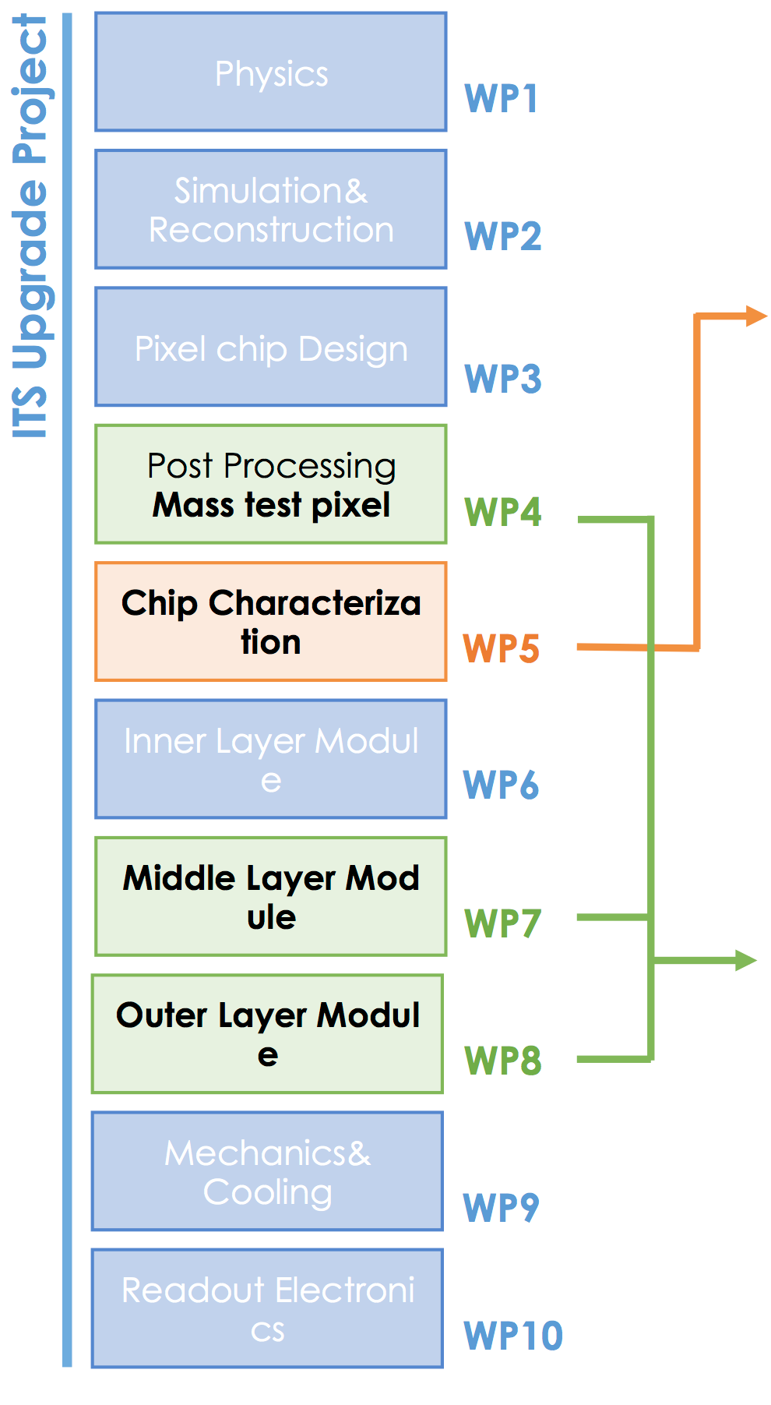
Inner Tracking System Upgrade
Characterization of pixel chip (Inha and PNU)
  Lab. & beam tests at PAL and KOMAC
Mass Chip Test (Inha, PNU and Yonsei)
  Test 60k Pixel chips (’17.01 ~ ‘18.01)
Module assembly (Inha & PNU)
  Assemble ~400 modules (’17.05 ~ ‘18.04)

Slide 10
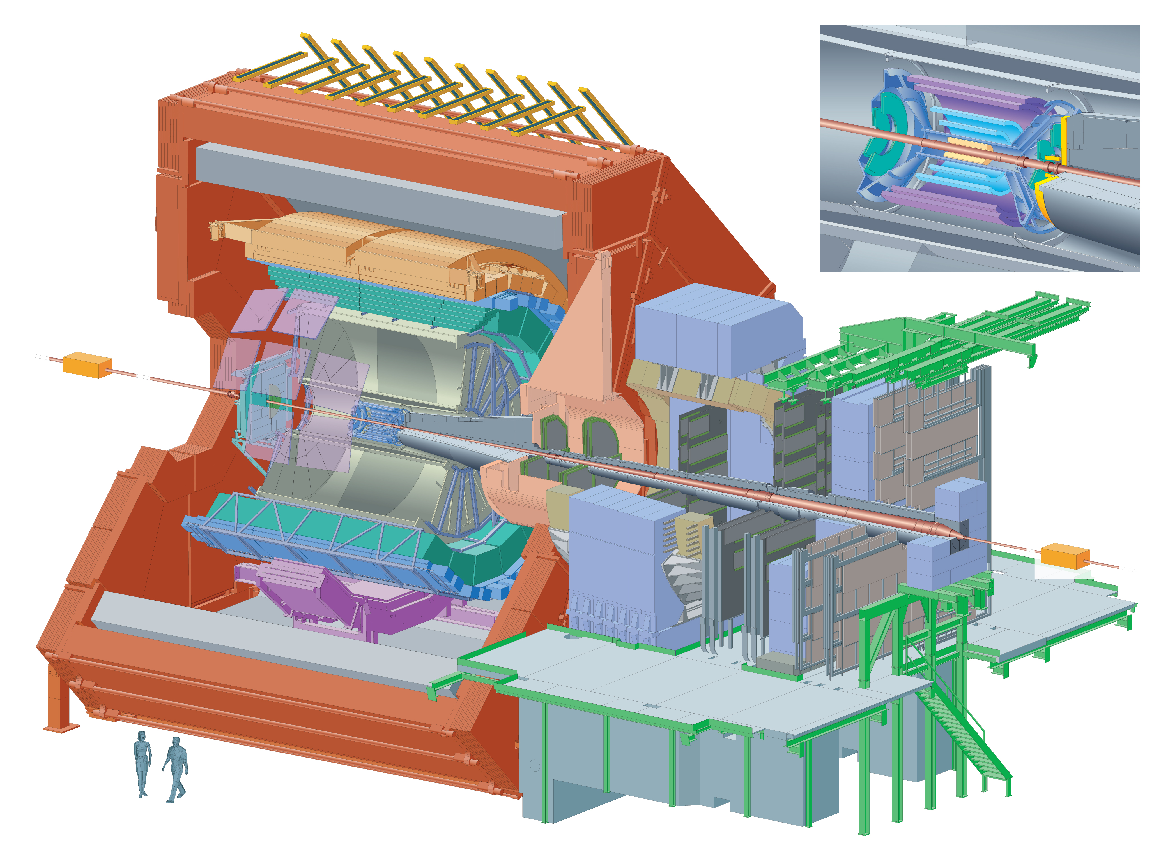
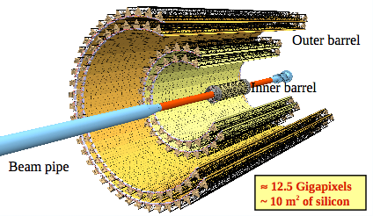
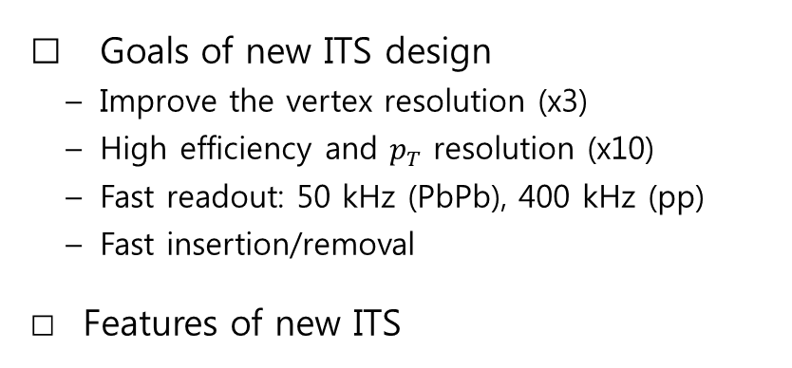
Inner Tracking System Upgrade
Goals of new ITS design
  Improve the vertex resolution (x3)
  High efficiency and $p_{T}$ resolution (x10)
  Fast readout: 50 kHz (PbPb), 400 kHz (pp)
  Fast insertion/removal
Features of new ITS
 | Current ITS | New ITS
# of layers | 6 | 7
Inner radius | 3.9 cm | 2.3 cm
Pipe radius | 2.9 cm | 1.9 cm
Innermost layer thickness | 1.14% X0 | 0.3% X0
Innermost layer pixel size | 50x425 μm² | 28x28 μm²
Max. PbPb readout | 1 kHz | 100 kHz
MAPS: Monolithic Active Pixel Sensor Technology

Slide 11
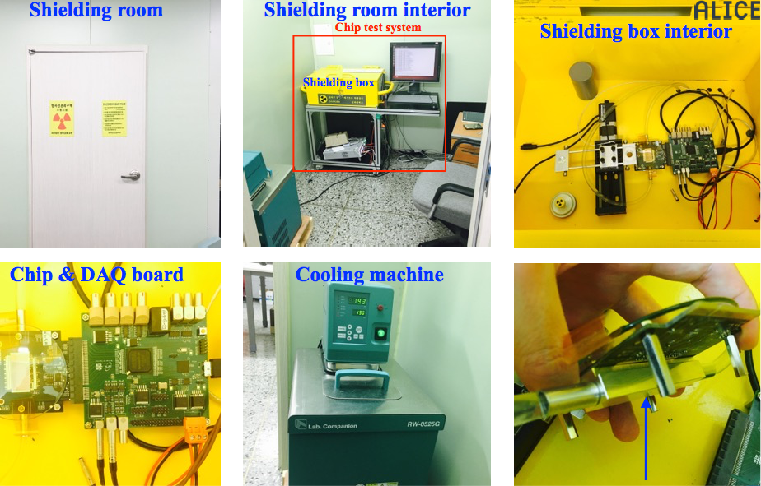
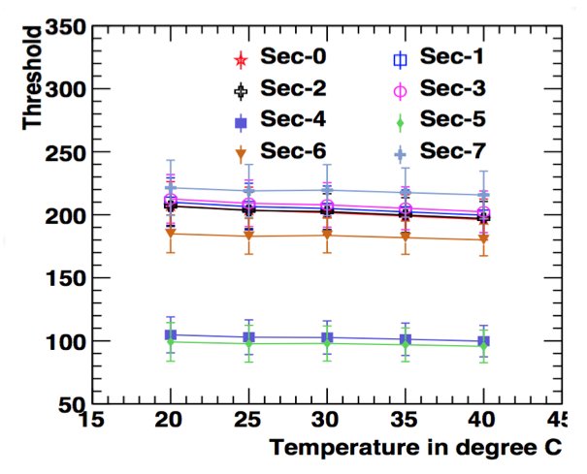
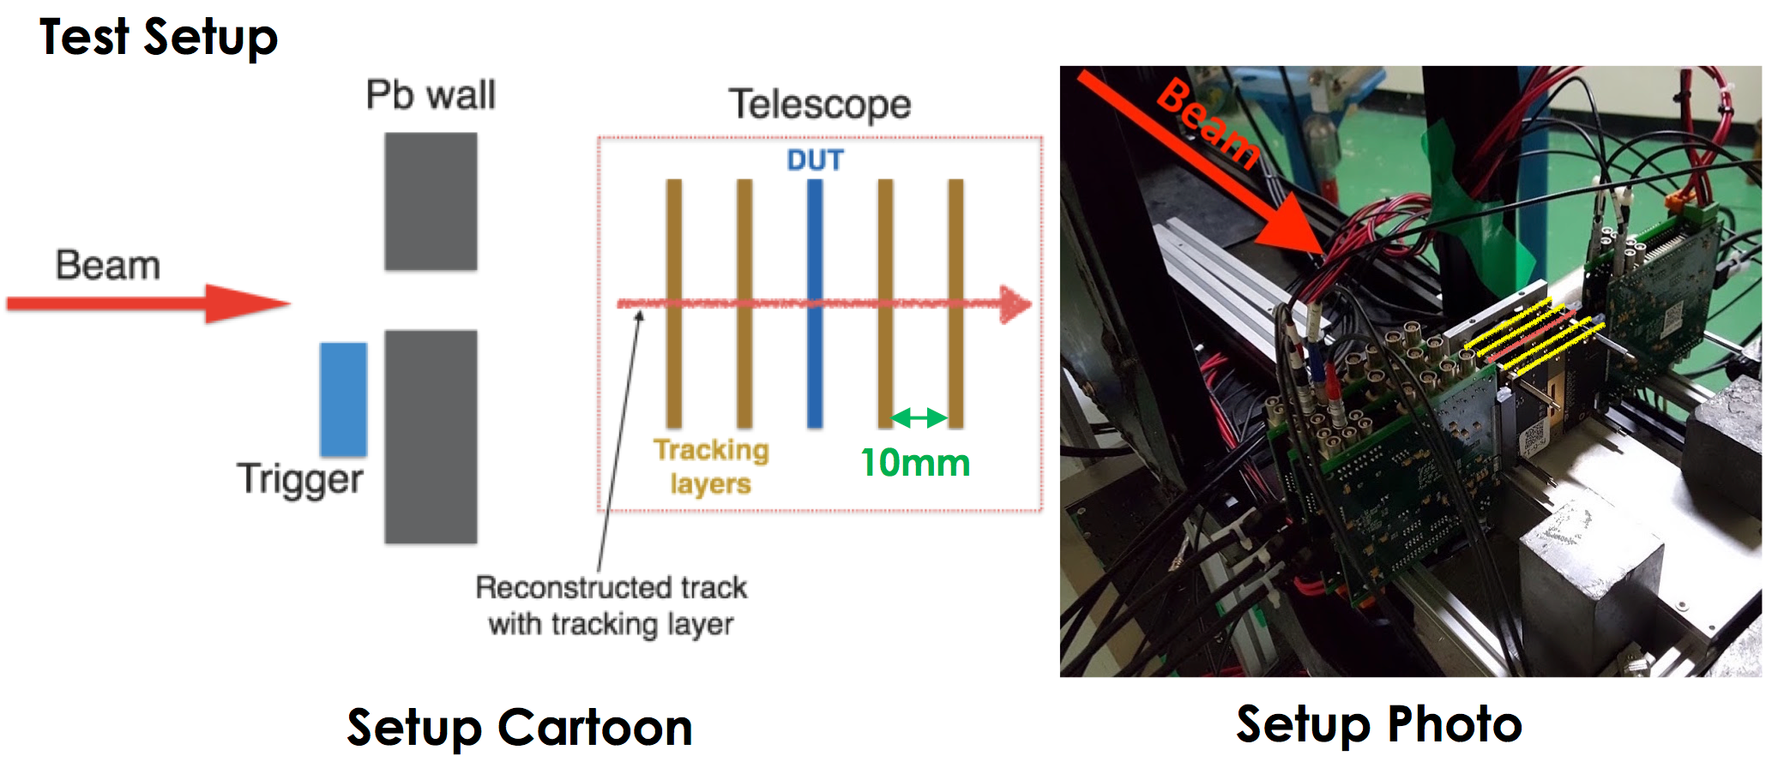
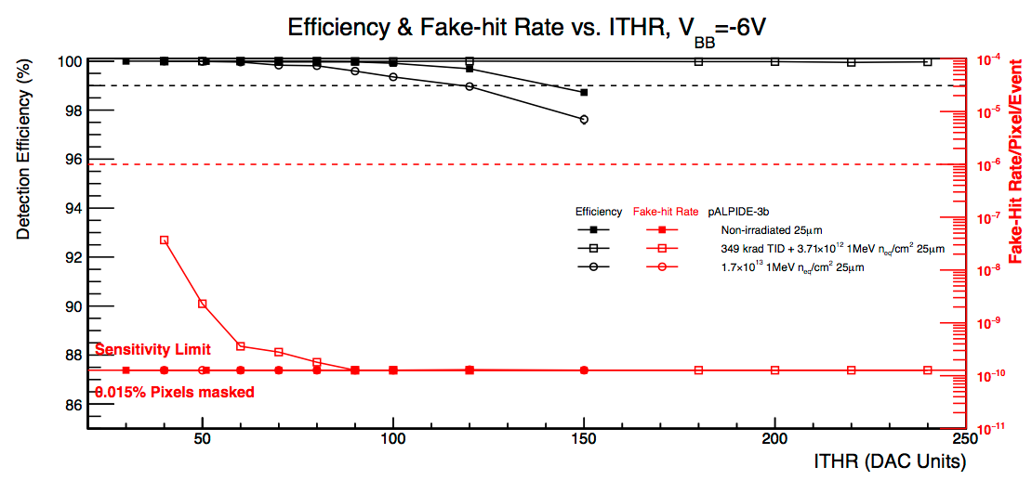
Setup for Chip Characterization
Lab test setup
Beam test setup

Slide 12
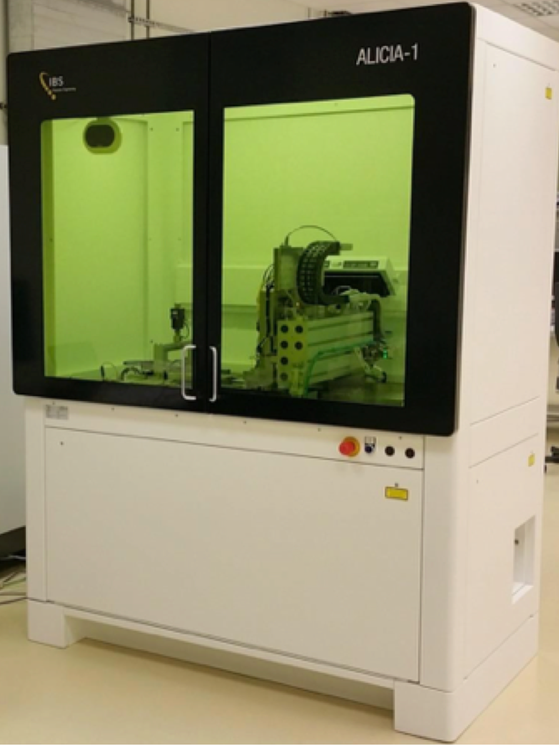
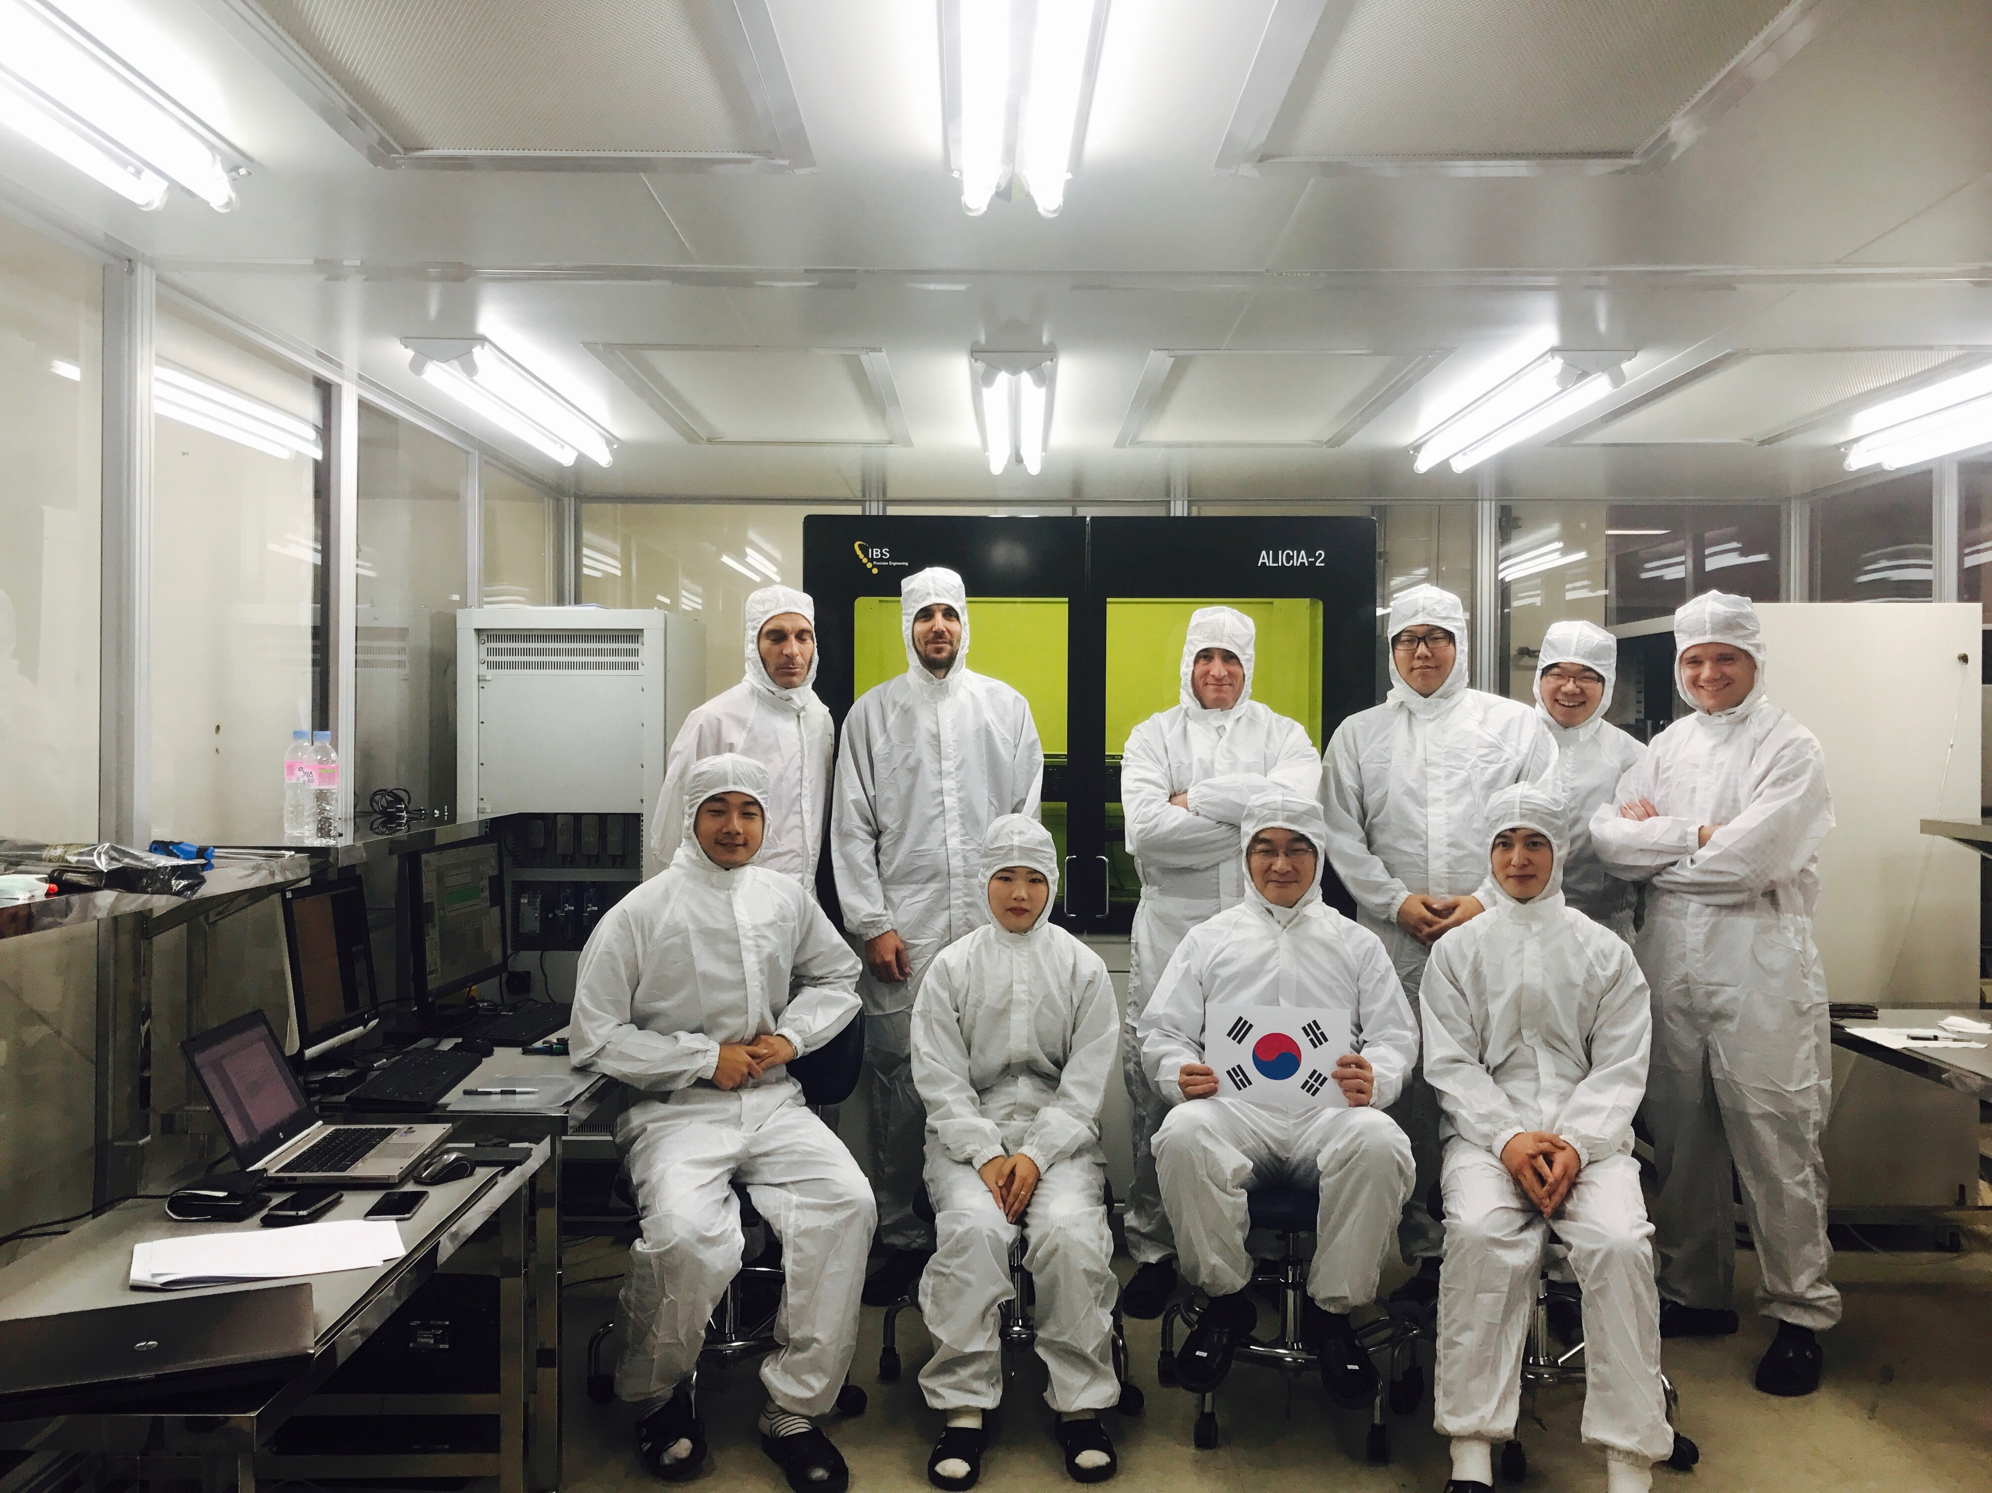
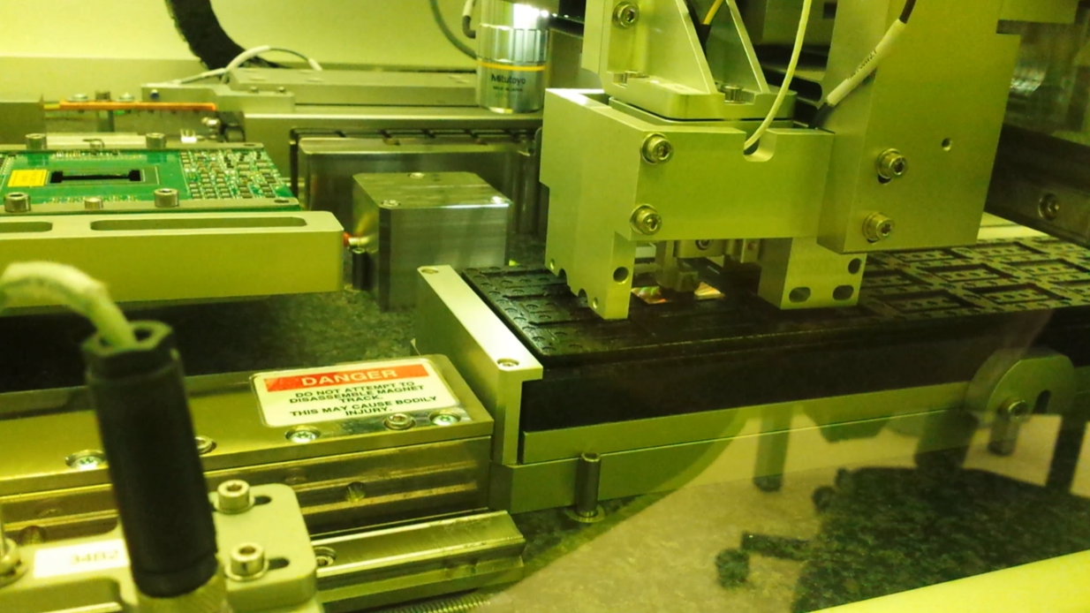
Mass Chip Test and Module Assembly Center in Korea
Mass chip test &
Module assembly machine
Clean room

Slide 13
Korea in CMS
Analysis topics
  Quarkonium production in pPb and PbPb
  Azimuthal anisotropy of quarkonium in PbPb
  Upsilon production in PbPb
  B production in pPb
  Isolated photons in PbPb
  Jet-photon correlation in PbPb
  Pomerons in ultraperipheral collisions
Hardware contribution
  Forward RPC upgrade
  High-rate muon trigger with GEM
Some highlights in the next slides

Slide 14
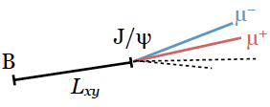
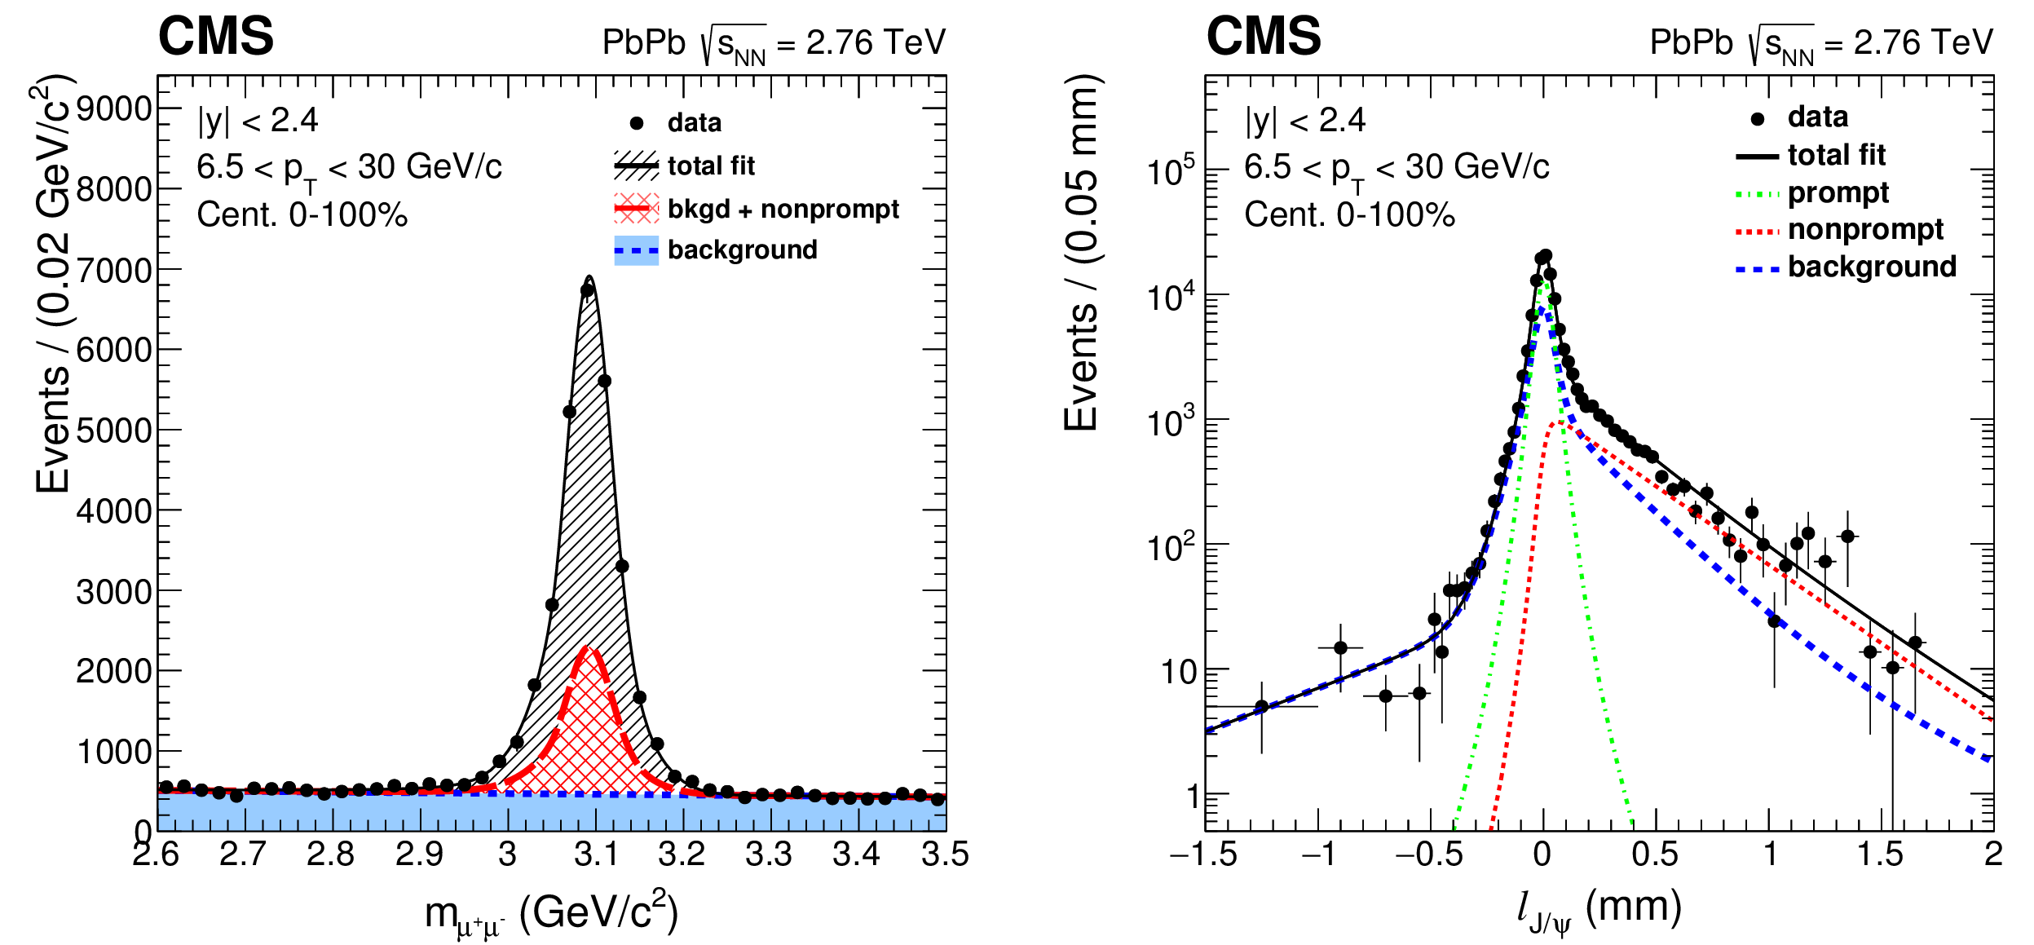

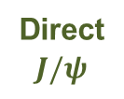
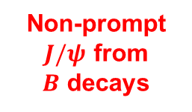
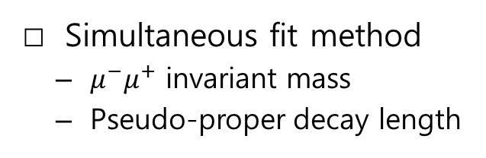
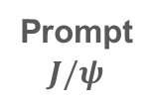

Prompt & Nonprompt $J/ψ$
Direct
$$J/ψ$$
Simultaneous fit method
  $μ^{−}μ^{+}$ invariant mass
  Pseudo-proper decay length
Prompt
$$J/ψ$$
Feed-down
from
ψ′ and χ_{c}
Inclusive
$$J/ψ$$
Non-prompt
$J/ψ$ from
$B$ decays

Slide 15
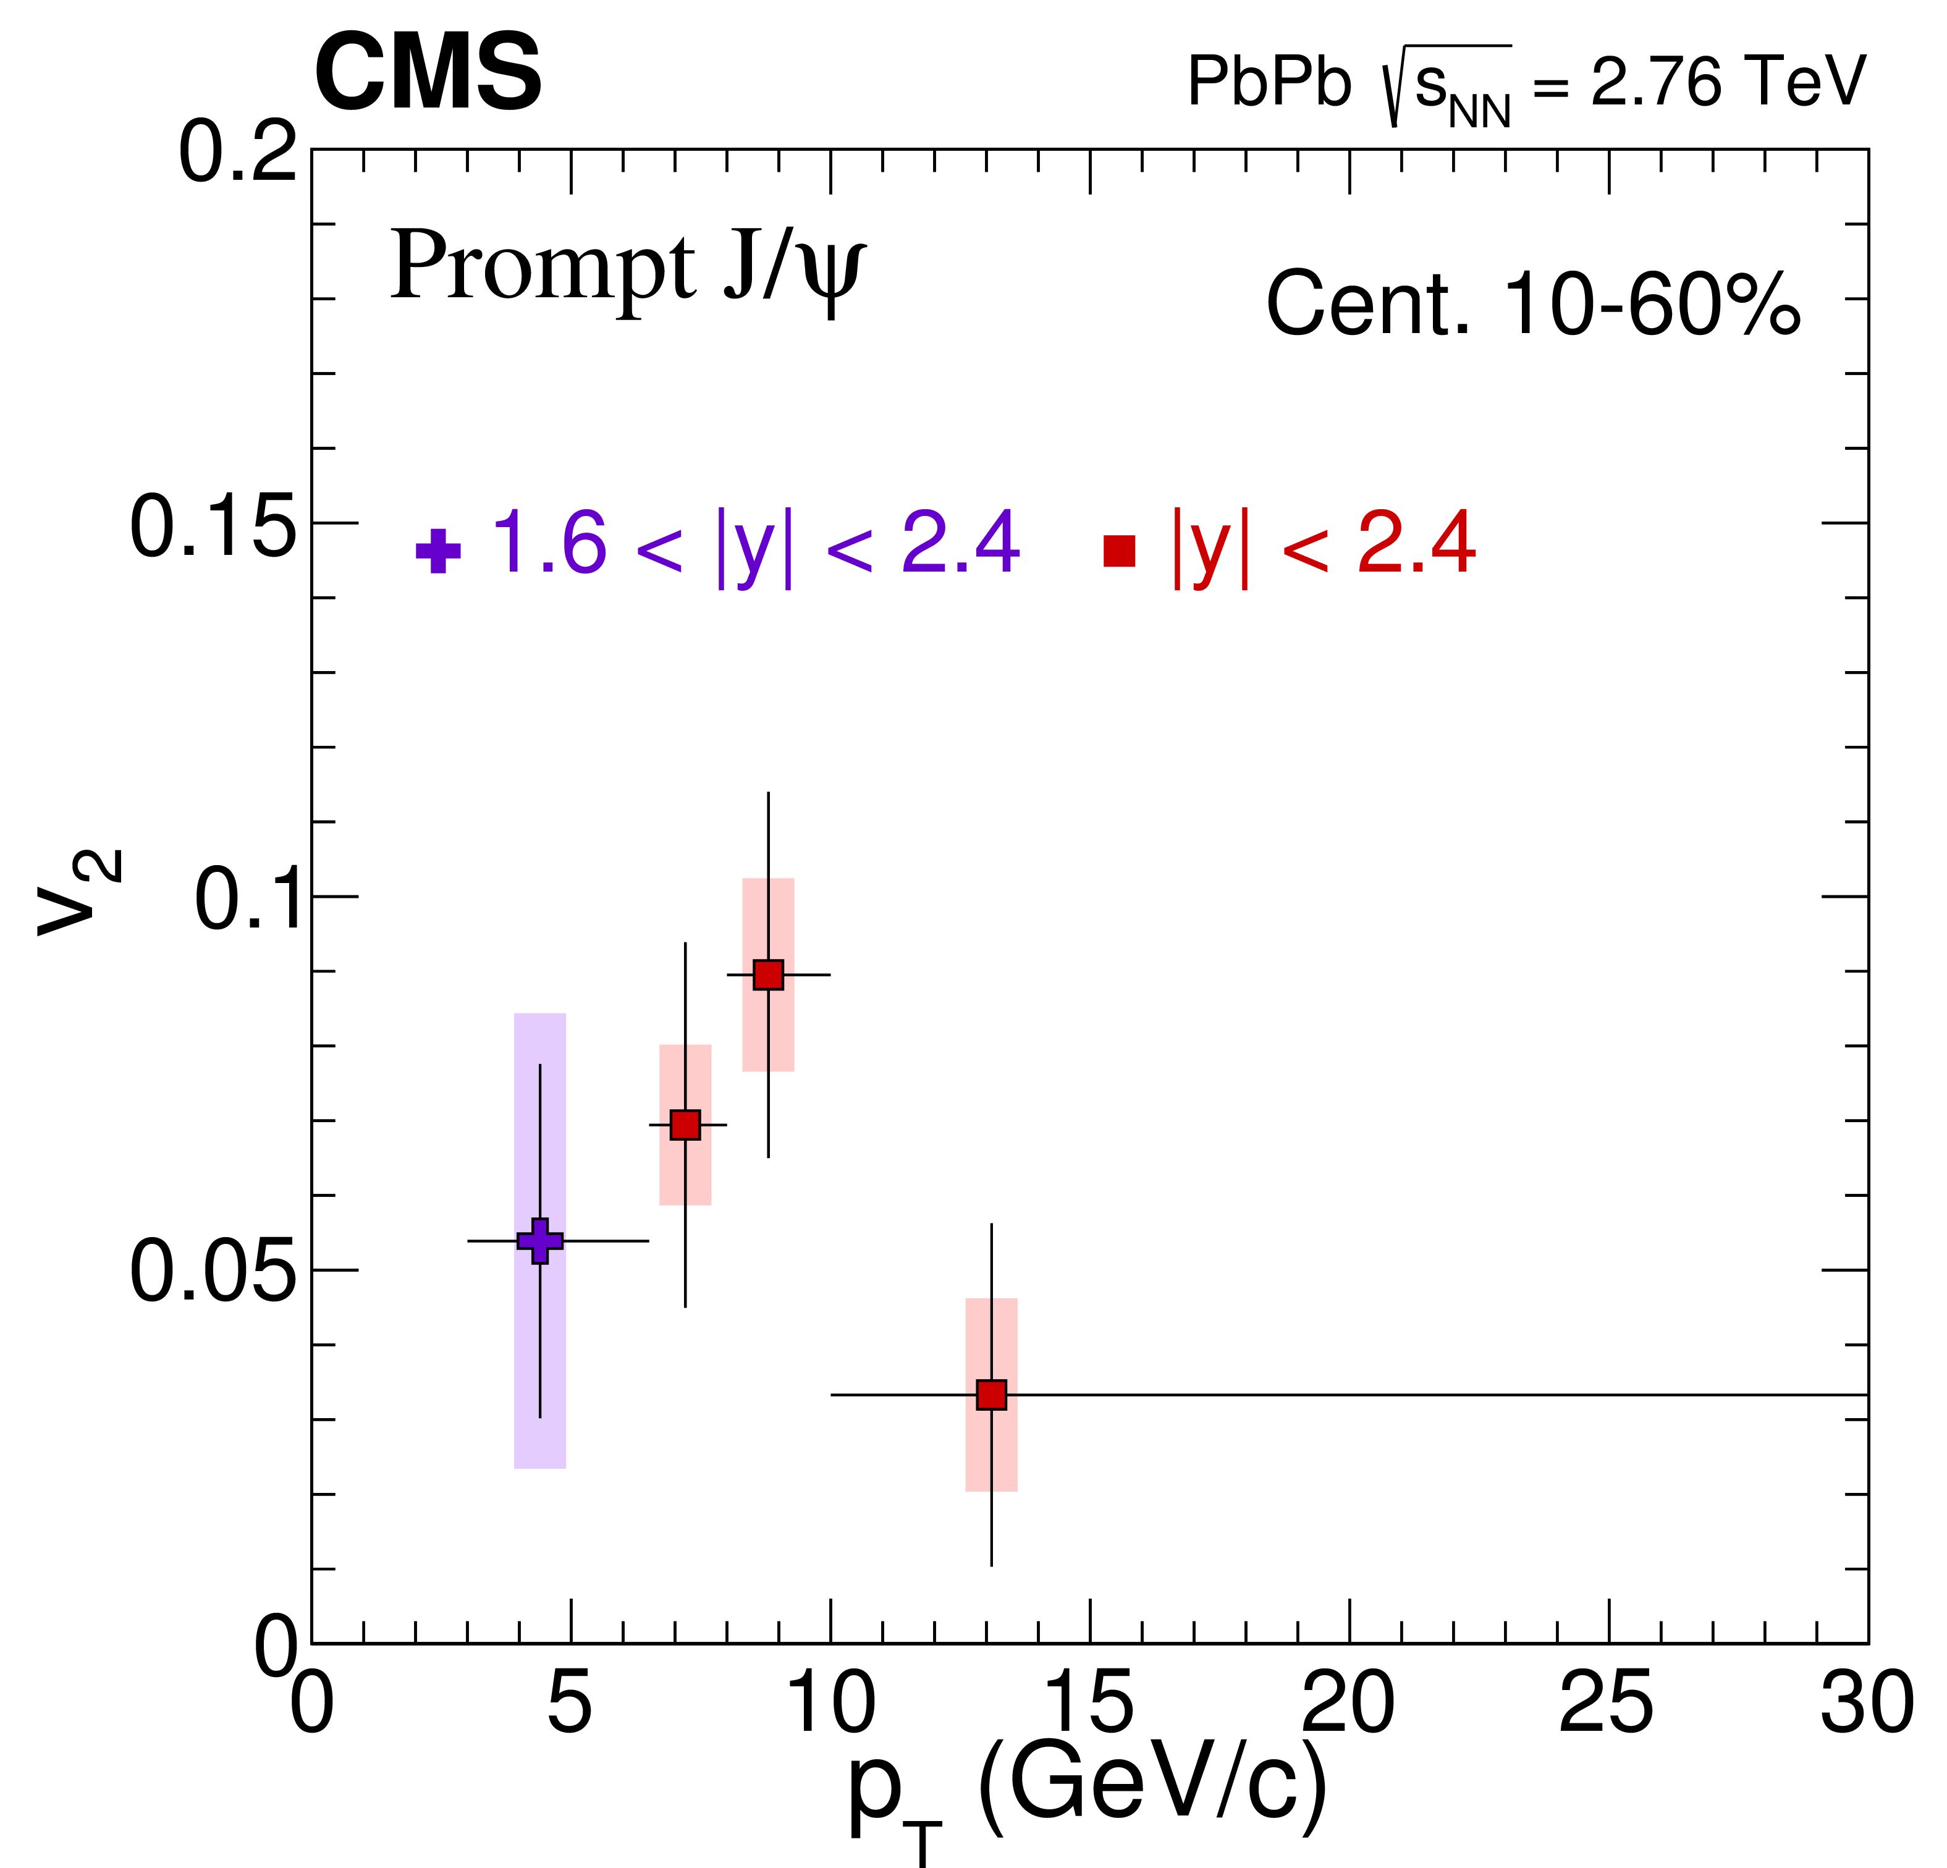
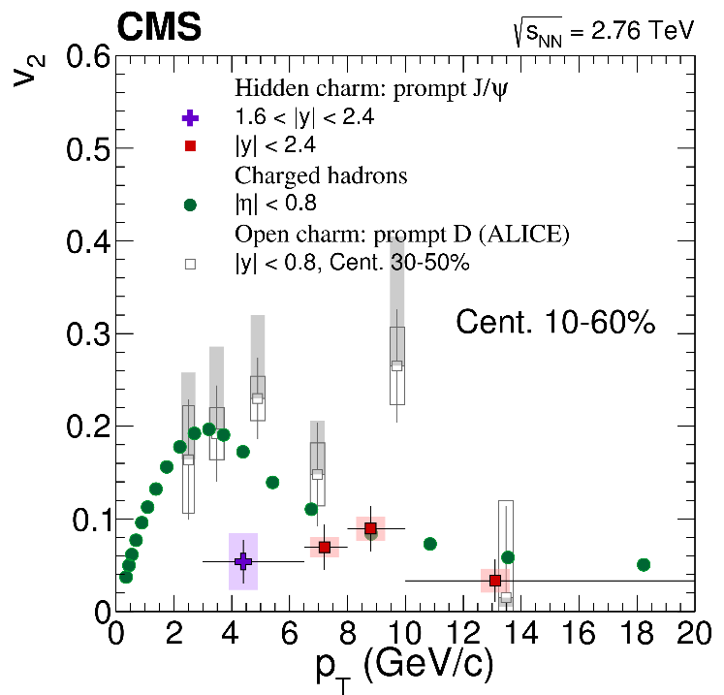
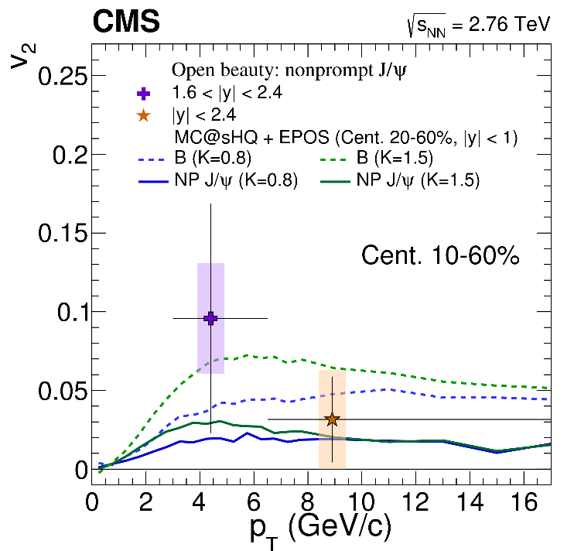
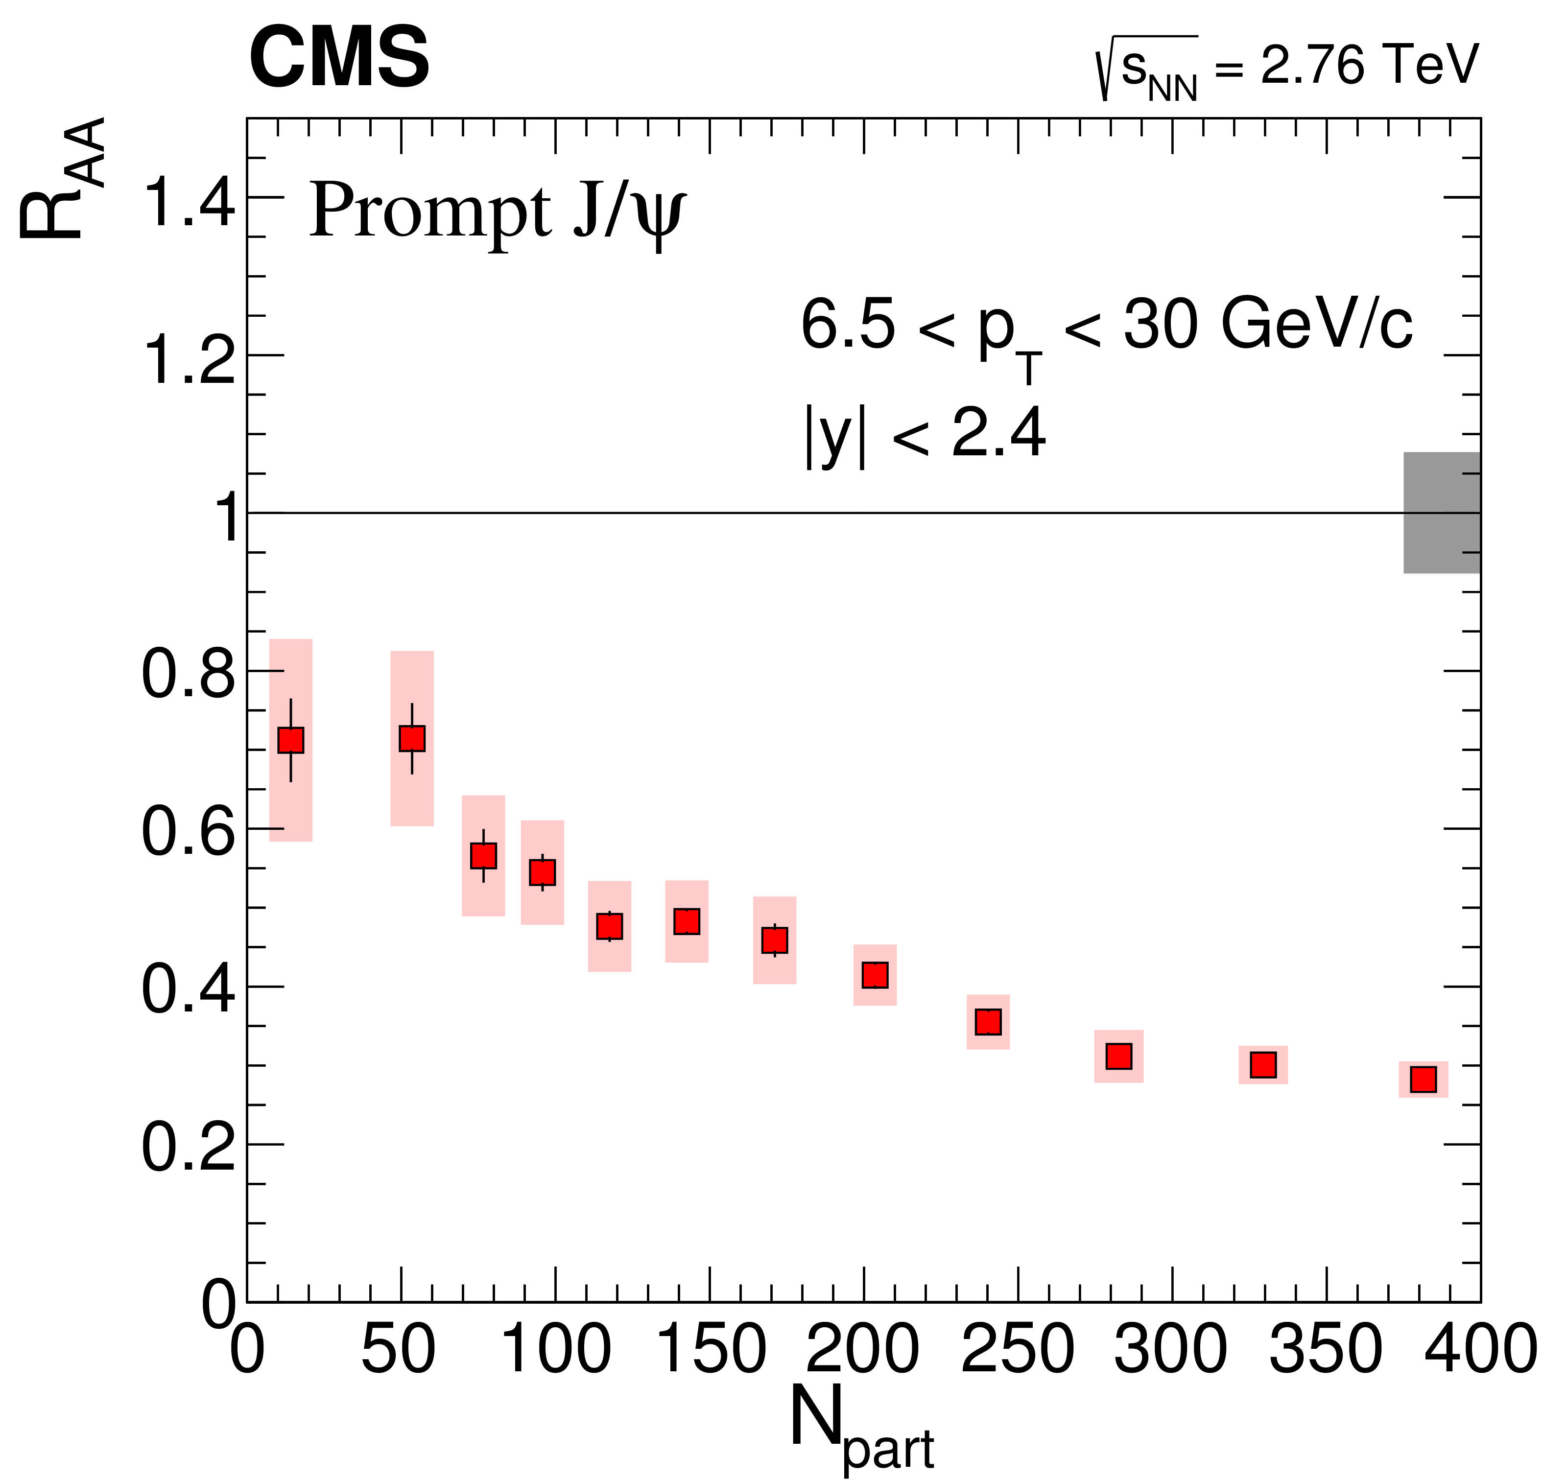
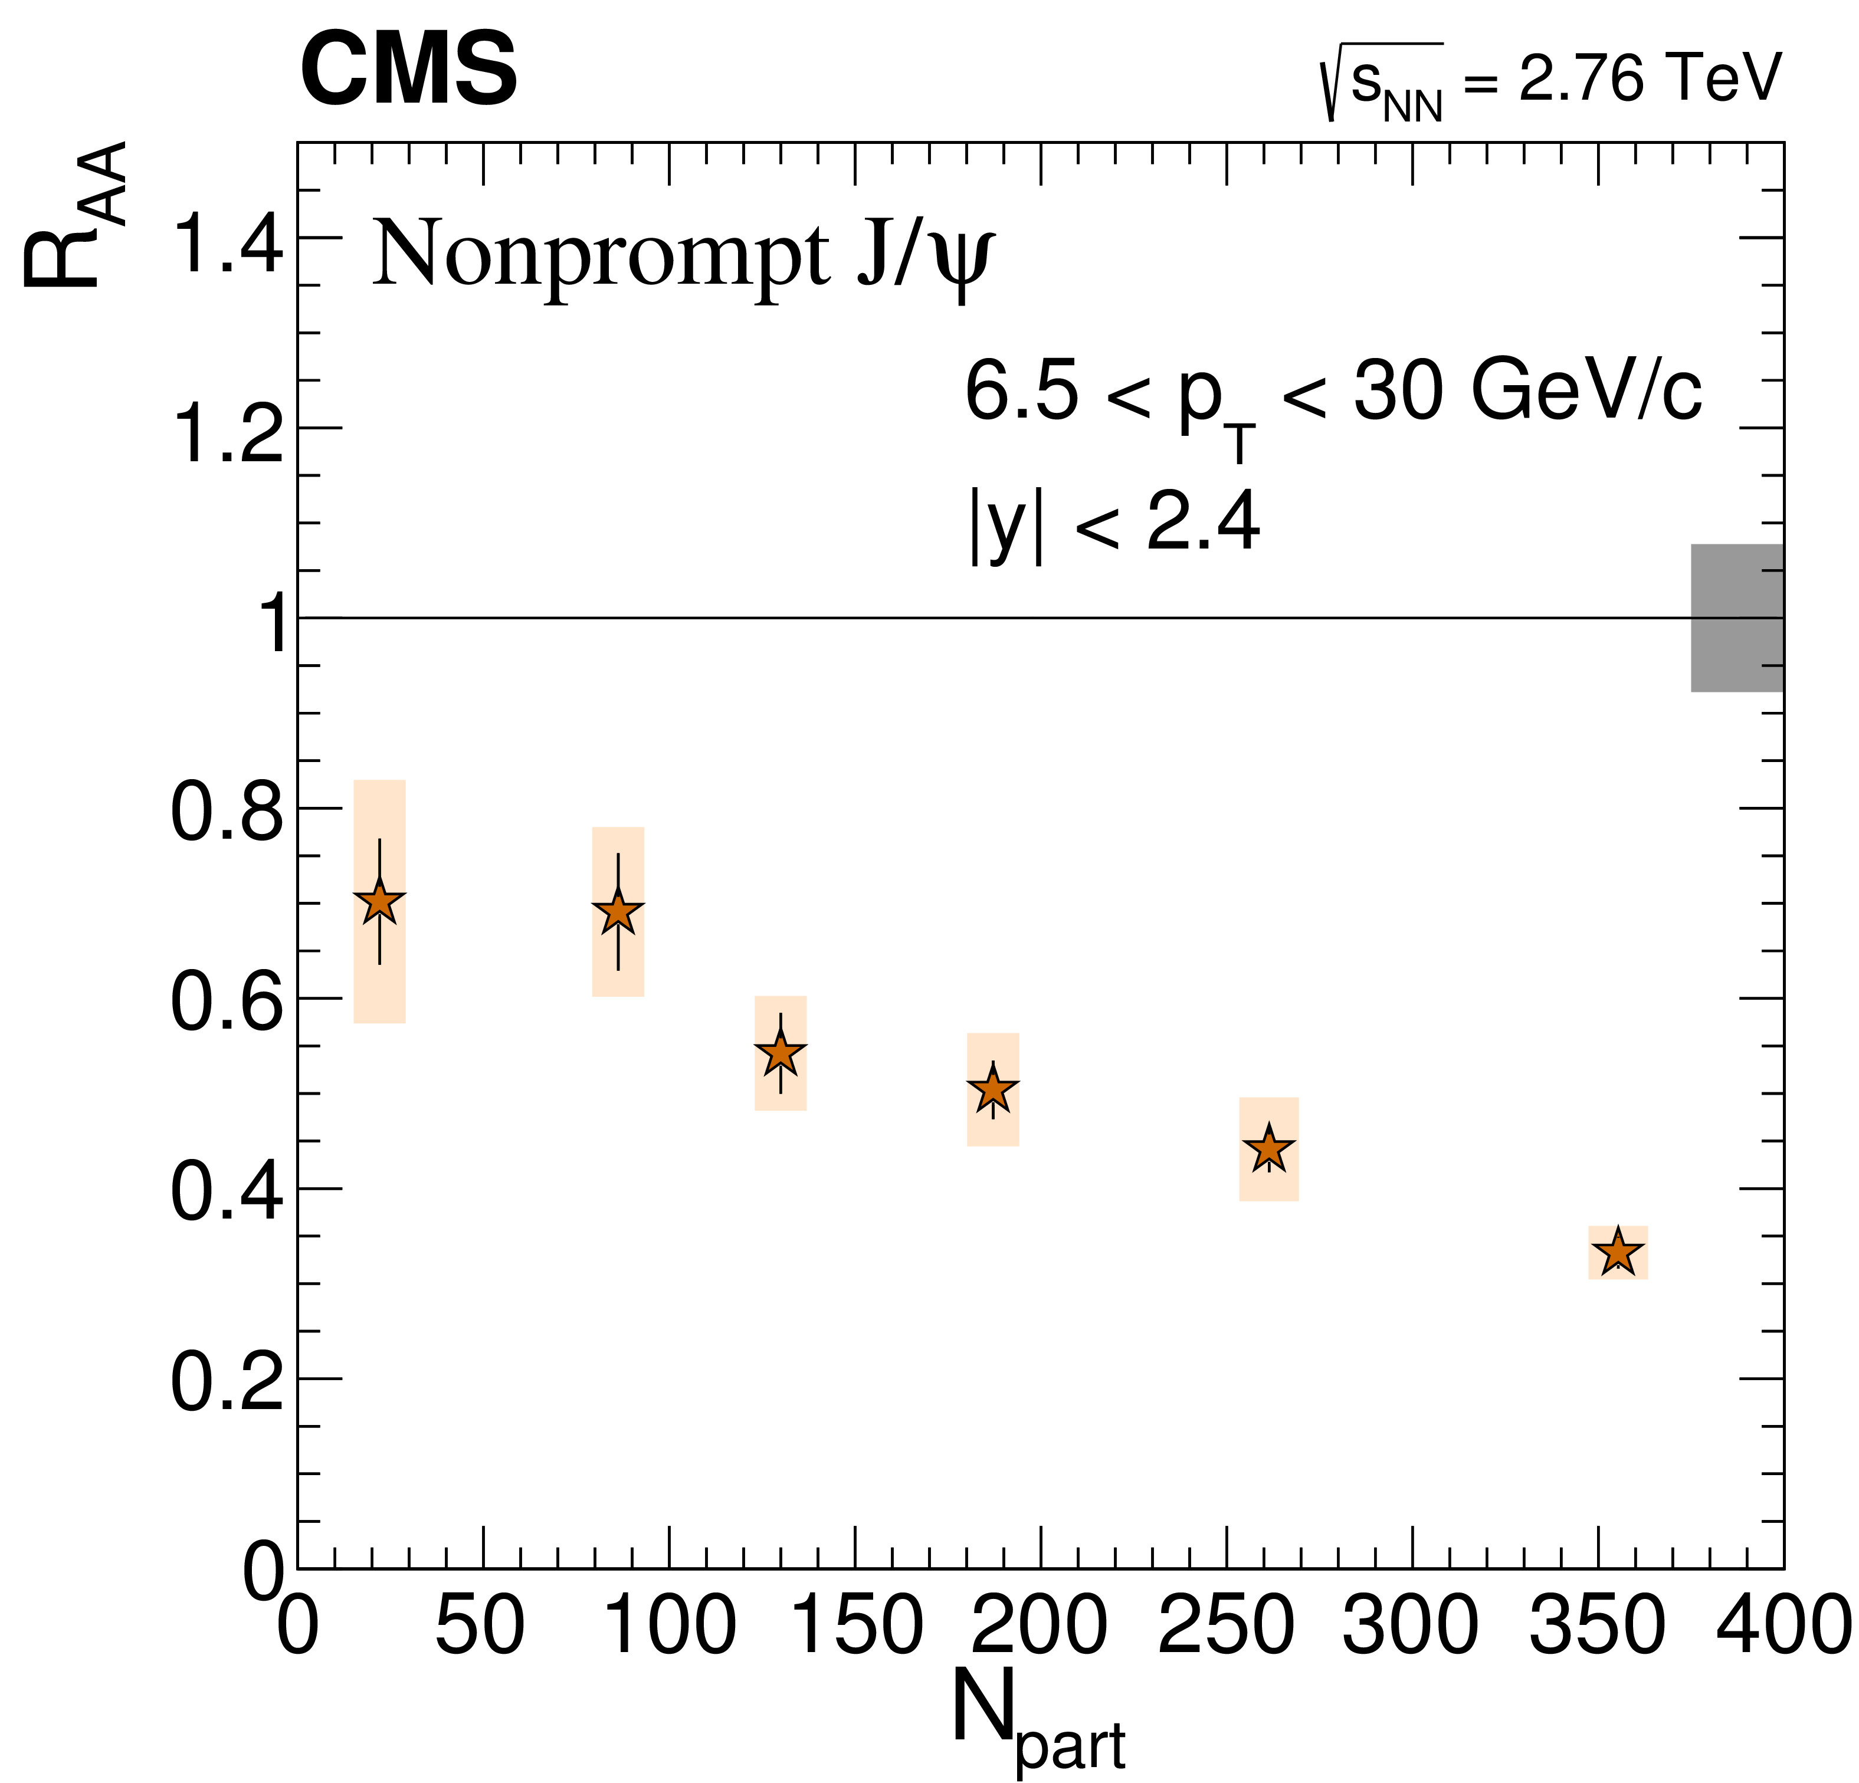
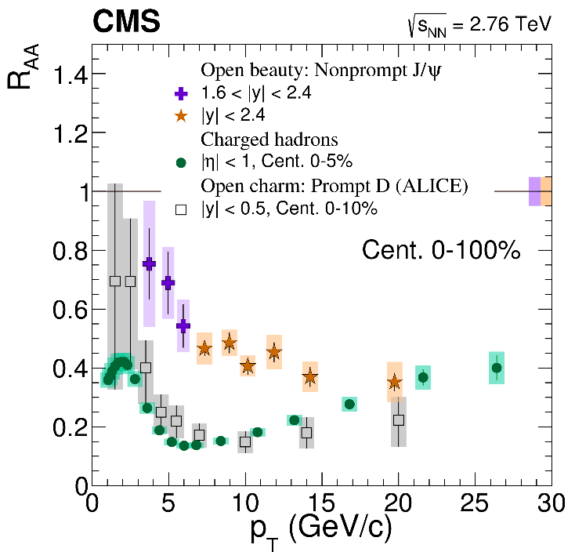

$J/ψ$ in PbPb
Submitted to EPJC, arXiv:1610.00613

Slide 16
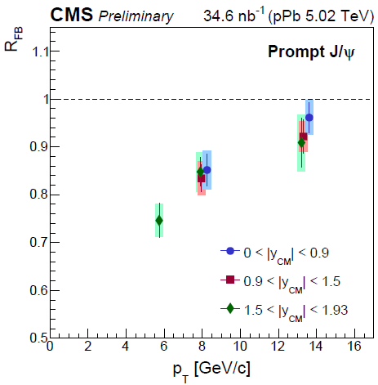
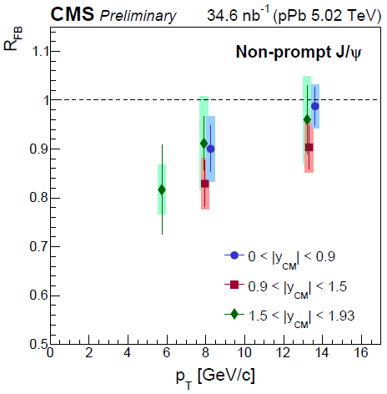
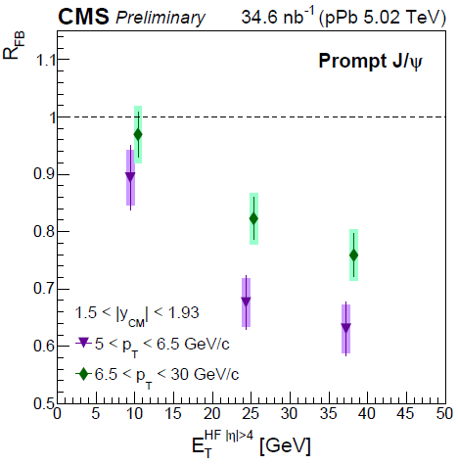
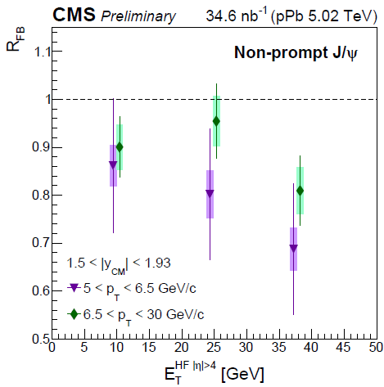
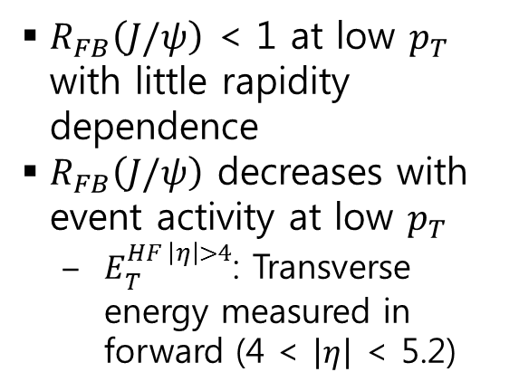
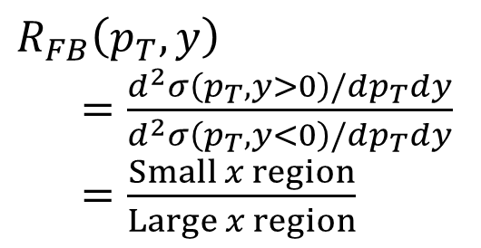

$J/ψ$ in pPb
CMS-HIN-14-009
$R_{FB}\left(p_{T},y\right)$
$=\frac{d^{2}σ\left(p_{T},y>0\right)/dp_{T}dy}{d^{2}σ\left(p_{T},y<0\right)/dp_{T}dy}$
$=\frac{Small x region}{Large x region}$
$R_{FB}\left(J/ψ\right)$ < 1 at low $p_{T}$ with little rapidity dependence
$R_{FB}\left(J/ψ\right)$ decreases with event activity at low $p_{T}$
  $E_{T}^{HF \left|η\right|>4}$: Transverse energy measured in forward (4 < $\left|η\right|$ < 5.2)

Slide 17
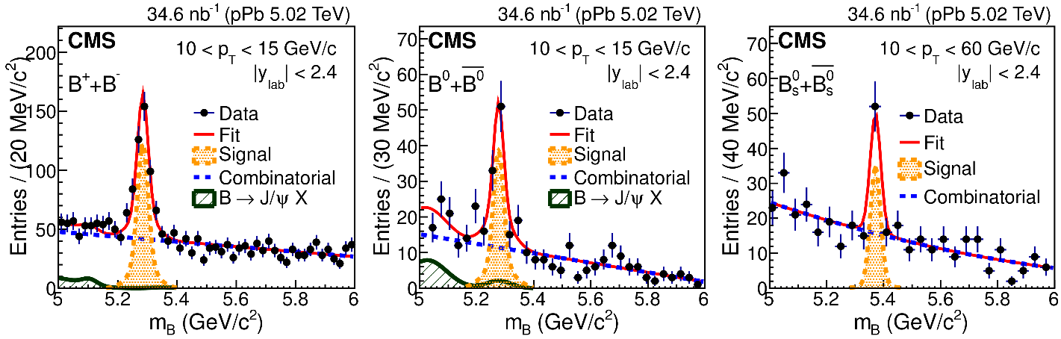

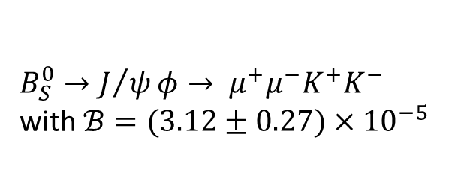
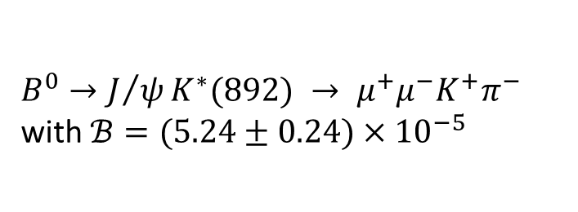
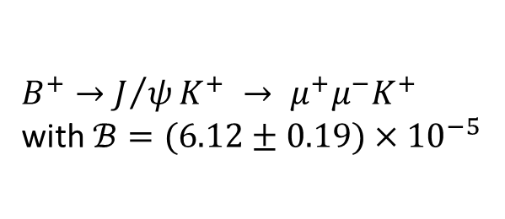
$B$ in pPb
$B^{+}→J/ψK^{+} → μ^{+}μ^{−}K^{+}$ with $ℬ=(6.12±0.19)×{10}^{−5}$
$B^{0}→J/ψK^{∗}(892) → μ^{+}μ^{−}K^{+}π^{−}$ with $ℬ=(5.24±0.24)×{10}^{−5}$
$B_{S}^{0}→J/ψφ→ μ^{+}μ^{−}K^{+}K^{−}$ with $ℬ=(3.12±0.27)×{10}^{−5}$
PRL 116, 032301 (2016)

Slide 18
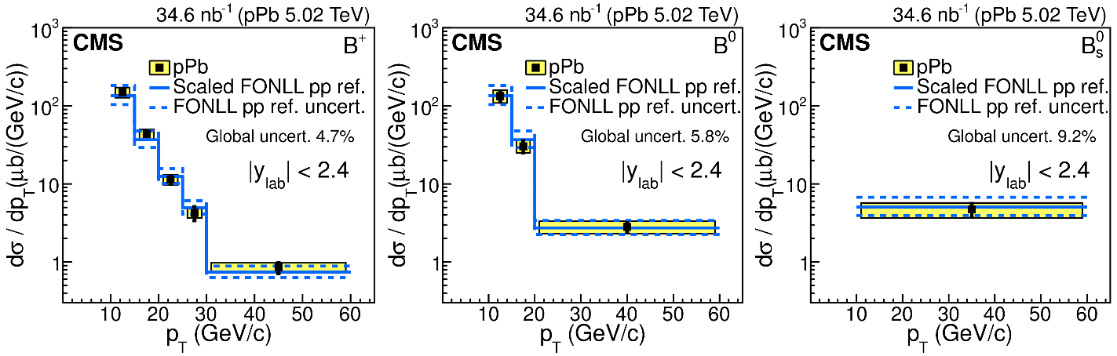
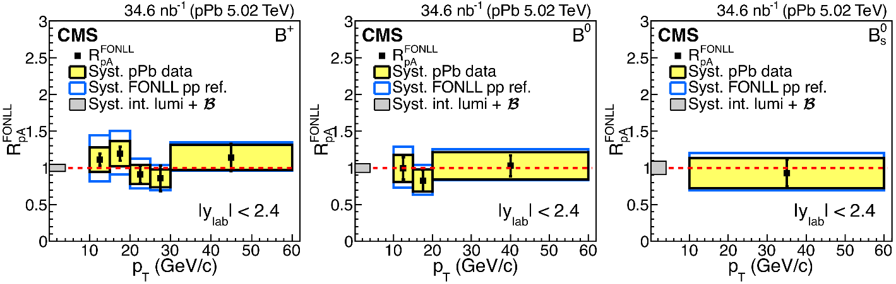
$B$ in pPb
PRL 116, 032301 (2016)

Slide 19
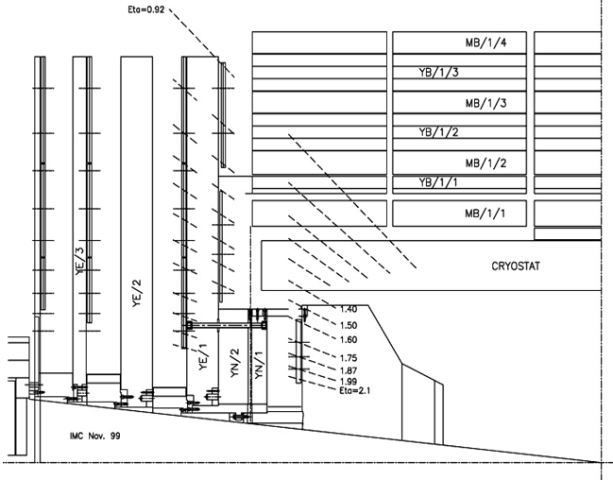
Current RPC System in CMS
Endcap RPCs
- 2 wings (RE+, RE-)
- 4 stations (RE1, RE2, RE3, RE4) in each wing
- Covering 0.92 < η <2.1
Barrel RPCs
- 6 stations (layers)
- Fully covering up to η = 0.8
- Partially covering up to η ~ 1.2
Low-η
Forward
RPCs
4th Station
via PHASE I
upgrade
(2014)
RE3
RE2
RE1
RE4/3
RE3/3
RE2/3
Barrel RPCs
RE1/3
RE4/2
RE3/2
RE2/2
RE1/2
High-η Forward
RPCs (Plan)
RE4/1
RE3/1
RE2/1
GE1/1
RE3/1
GE2/1
Wednesday, November 23, 2016

Slide 20
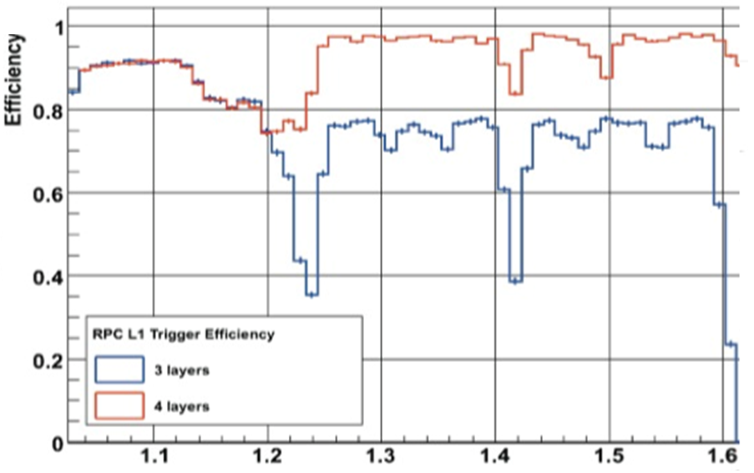
Phase II: Upgrade of CMS RPC
Current ENDCAP composed of 4 RPC stations covering 1.1 <η< 1.6
  Trigger efficiency of the muon system is still low due to absence of the RPC in 1.6 <η< 2.4 range.
Completion of 36 RE3/1 and 36 RE4/1 RPCs together with GE0, GE1/1, and GE2/1, before LS3 (2024).
  2015 – 2017: Confirmation of detector technology
  2017 – 2018: Pre-productions
  2019 – 2023: Detector productions, installation, and integrations
After 2014
RPC Trigger Efficiencies
RED: requiring 3/4 with a new 4th station
BLUE: requiring 3/3 with 3 stations
Before 2014
!!!
Endcap RPCs only

Slide 21
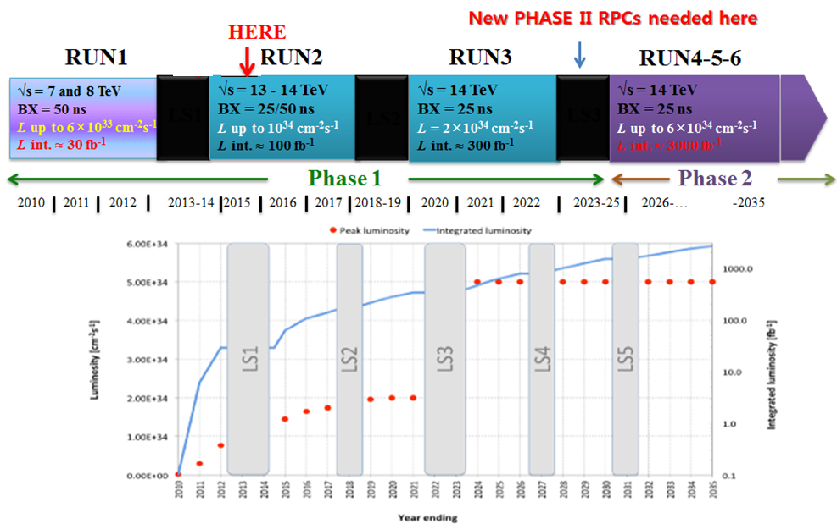
Phase II: Extension of Endcap Muon Trigger System
GE1/1
GE2/1

Slide 22
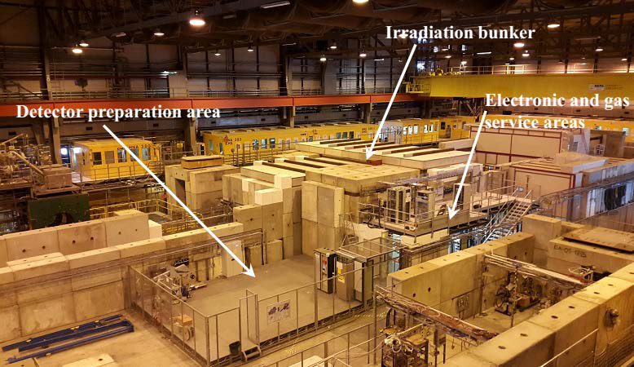
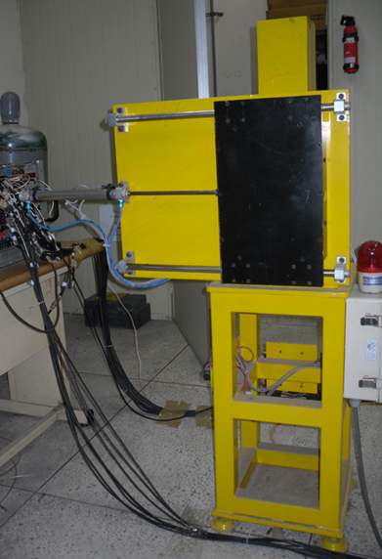




R&D for high-$η$ CMS RPCs
200-mCi ¹³⁷Cs at Korea University
Current activity = 5.55 GBq
Maximum $γ$ rate at 37 cm~1.4 kHz cm⁻²
H4 beam line at GIF++
Activity = 1.4 TBq (¹³⁷Cs)
Maximum $γ$ rate at the test position~1.5 kHz cm⁻²

Slide 23
Experimental Status of LENS
Subject | Accelerator | Experiment | Participating institutes
Nuclear Astrophysics | RIBF | CRIB SAMURAI | Ewha Womans, IBS, Sungkyunkwan
 | RAON | KOBRA | IBS, Chung-Ang, Ewha Womans, Hanyang, Hoseo, Kyungbook Nat., Sungkyunkwan
Nuclear Structure
 | RIBF | EURICA SAMURAI | Ewha Womans, Hoseo, IBS, Korea, Seoul Nat., Sungkyunkwan
Nuclear Matter (Symmetry energy) | RIBF | SπRIT | Korea, IBS
 | NSCL |  | Korea, IBS
 | RAON | LAMPS | Korea, IBS, Chonbuk Nat., Chonnam Nat., Inha

Slide 24


Break-Out Reactions
K. I. Hahn @ Ehwa Womans Univ.
CRIB
  ¹⁴O(α,p)¹⁷F and ¹⁵O(α,g)¹⁹Ne, from HCNO cycle to the rp-process
Primary target H_{2,}
400 torr
80K
¹⁴N beam @ 8.4 MeV/u from the AVF cyclotron
¹⁴O+⁴He results:
Recently published in
Kim et al.,
PRC 92, 035801 (2015)
Wien filter
Secondary
¹⁴O (RI) beam

Slide 25

Break-Out Reactions
SAMURAI
  ⁶⁷Se beam on Be target to study the rp-process and the structure of ⁶⁶Se

Slide 26




Plan at KOBRA
Unstable nuclei play a key role in the nucleosynthesis
→ Accurate nuclear reaction rates are indispensable.
Future plan with the KOBRA collaboration
- Breakout reactions: ¹⁴O(α,p)¹⁷F, ¹⁸Ne(α,p)²¹Mg, ¹⁵O(α,γ)¹⁹Ne
- rp-process: (p,γ) reaction rates under explosive hydrogen burning
- s-, r-process: (n,γ) reaction rates along the path, r-process waiting point nuclei
- αp-process: (α,p) reaction rates for waiting point nuclei in XRBs - ²²Mg, ²⁶Si, ³⁰S, ³⁴Ar

Slide 27

α−Cluster Structure of ²²Mg
⁷Be+α
K. Chae @ Sungkyunkwan Univ.
α-cluster structure can be characterized by E levels with large reduced α widths
Mostly for 4N nuclei with N=Z
  (⁸Be, ¹²C, ¹⁶O, ²⁰Ne, …)
Extended to some neutron-rich nuclei
  (¹⁰Be, ¹¹B, ¹²Be, ¹⁶C, ¹⁸O, ²²Ne, …)
Rare information on proton-rich nuclei:
  (¹¹C, ¹⁸Ne, ²²Mg, …)
Symmetry holds very well for ¹¹C and ¹¹B in terms of the α-cluster structure (left)
⁷Li+α
M. Freer et al., PRC 85, 014304 (2012)
(Q) Does the symmetry hold for ²²Ne and ²²Mg?
We can answer this question by measuring the ¹⁸Ne(α,α)¹⁸Ne scatterings!
⁷Be(α,α)⁷Be measurement in inverse kinematics @ HRIBF

Slide 28


¹⁸Ne(α,α)¹⁸Ne at CRIB
¹⁶O beam
F3
¹⁶O primary beam from the AVF cyclotron
¹⁸Ne beams are produced by the ¹⁶O(³He,n)¹⁸Ne reaction.
  Beam intensity ~ 3*10⁵ pps
Reaction target chamber filled with ~470 Torr ⁴He gas (thick target)
Scattered α particles were detected by two ΔE-E telescopes for particle identification

Slide 29

¹⁸Ne(α,α)¹⁸Ne Results
¹⁸Ne(α,α) measurement and ¹⁸Ne(⁴⁰Ar,α) background run
The background run was performed to see if the detected α particles were originated from contaminations
After the background event subtraction, four resonances in ²²Mg were identified!
They will be compared with the reaction cross section with R-matrix calculation to extract resonance parameters.
¹⁸Ne(α,α)
¹⁸Ne(⁴⁰Ar,α)

Slide 30


KOBRA @ RAON
F4
F5
F3
(RAON)
Stage 2 (Optiona1)
Reaction target chamber
Wien Filter
ECR
Stable ion beams
via SCL1 or SCL3
RI beams
F2
SCL1
RIB via ISOL+SCL3
Stage 1
SCL2
Target chamber
ISOL
Primary beams
SCL3
F1
ECR
Beam dump chamber
F0
Stage 1+Stage 2
  High-resolution separator at a few~25 MeV/u: primary beam dispersion matching of stage 1
  Recoil mass separator at ~1 MeV/u: radiative capture mode (under discussion)
  RI beam production and dispersion matching: secondary beam dispersion matching mode (under discussion)
Stage 1
  Production mode: RIB up to ~25 MeV/u
    (p,n), (d,p), (d,n), (³He,n) at a few MeV/u
    Multi-nucleon transfer reactions at 25 MeV/u
  Radiative capture mode: Recoil mass separator at about 1 MeV/u

Slide 31





Case study using Monte-Carlo simulation
RI beam Production mode
Radiative capture mode
Production of ²⁴O using 30 MeV/u ⁴⁰Ar beam with Be target
¹⁵O(α,ϒ) ¹⁹Ne at 0.16 MeV/u
Production of ¹²Be using 40 MeV/u ¹⁸O beam with Be target
(homogeneous degrader at F1)
⁶⁵As(p,ϒ) ⁶⁶Se at 1.8 MeV/u

Slide 32

Physics Program of KOBRA
Nuclear structure
  Shell evolution in p- and n-rich nuclei
    Excitation energy & angular distribution
    Nucleon occupancy in single particle orbit: inelastic scattering, (d,p) reaction, and nucleon removal reaction, etc.
  Soft (and Pygmy) dipole resonances using nuclear probe, e.g., α, Ca and Pb
    Excitation energy and angular distributions for bound states (via γ-ray spectroscopy) and unbound states (via missing mass method)
Nuclear Astrophysics
  Direct measurement of charged-particle capture cross section, e.g., for ⁶⁵As(p,γ) and ¹⁵O(α,γ) reactions at $≲$ 1 MeV/u
  Indirect measurement of radiative capture cross section, e.g., for (d,p) reaction at a few MeV/u
F4
F5
Stage 2 (Option 1)
F3
Reaction target chamber
Wein Filter
RI beams
F2
Stage 1
Target chamber
F1
Primary beam
F0
Bam dump chamber

Slide 33

Schedule

Slide 34


LAMPS @ RAON
(RAON)
ECR
Stable ion beams to IF target via SCL1+SCL2
SCL1
RIB to IF target via ISOL+SCL3+SCL2
SCL2
ISOL
SCL3
ECR
Si-CsI
Neutron array

Slide 35


Neutron Detector Array
veto
Dimensions of each bar: 0.1Χ0.1X2.0 m³
Construction of the real-size prototype detectors and test of their performances using
  Radiation sources: ⁶⁰Co and ²⁵²Cf
  Neutron beams at RCNP

Slide 36


NDA: Beam Test at RCNP
E479 approved in B-PAC in March 2016
Date: May 29, 2016 (Visited RCNP for May 22 – June 2)
Beam specifications
  Protons on Li production target
  Energies: 65 and 392 MeV in N0 beamline
  10 nA flux $×$ 1/9 chopping
2
2 stations with 1 veto layer

Slide 37




NDA: RCNP-E479
Total number of recorded events
  65 MeV: 13.6M
  392 MeV: 10.4 M
Chopping signal
CV signal

Slide 38

NDA: Preliminary Results
Energy resolution
392 MeV
T_{50% adc peak}
$$σ_{E}=3.17\%$$
Hit distribution
We will particularly test the newly developed neutron analysis code for multi-neutron events.
65 MeV
392 MeV

Slide 39


Time Projection Chamber
η=-0.7 (127º)
η=1.6 (24º)
One central Au+Au at 250 AMeV (IQMD)
400 mm
53.1°
24.0°
150 mm
Target
500
mm
300 mm
900 mm
Simulation with triple GEM readout using Garfield++
  Gas mixture: Ar 90%+CO₂ 10%, Voltage for each foil: 450 V
  <Gain>~1.4Χ10⁶, <Drift velocity>~50 mm/μs
  <Dispersion> after 60 cm (maximum drift distance) < 3 mm

Slide 40


Prototype TPC: Design
Half-size prototype TPC
Outer field cage
Triple GEM
Cathode
PAD
Drift length: 570 mm
150 mm
Inner field cage
490 mm
2013-12-17
진도관리 중간평가 (LAMPS)
40
Bottom Al frame for PAD & GEM

Slide 41




Prototype TPC: Assembly
Inner Field Cage installed
Outer Field Cage installed
Prototype TPC assembled
Prototype TPC: back

Slide 42



Prototype TPC: Test at ELPH
ELPH: Research Center for Electron Photon Science at Tohoku University
Dates: November 1-2, 2016
Beams: $e^{+}$ beams at 500 MeV
Purpose: To study the detailed characteristics, such as $v_{drift}$, diffusion and $σ_{x}$, of LAMPS TPC
We are analyzing the data.

Slide 43
Experimental Status of HaPhy
Subject | Accelerator | Experiment | Participating institutes
PDF, H-dibaryon, and Exotics, etc. | J-PARC | E42 | Korea, Seoul Nat.
 |  | E03, E05, E07, E13, E45, E14(KOTO), E50(High-p) | Korea
 | Spring-8 | LEPS, LEPS2 | Korea
 | CEBAF |  | Kyungpook Nat., Seoul Nat.

Slide 44



J-PARC E42 Experiment
J. K. Ahn @ Korea Univ.
Search for H-dibaryon on proton pair via $\left(K^{−}, K^{+}\right)$ reaction
$K^{−}$ beams on the diamond target at 1.7 GeV
Hyperon spectrometer aiming at 1 MeV $ΛΛ$ mass resolution!
Hyperon Spectrometer at K1.8 beamline
  HypTPC
  Superconducting Helmholtz Coil

Slide 45



HypTPC
Some features
  Gating grid $−$ Triple GEM layers
  Concentric pad plane (5768 pads) $−$ Gain ~10⁴
  Position resolution: < 300 μm
  Momentum resolution: ${Δp}/p=1\sim 3\%$ for π and p

Slide 46




Beam Test at ELPH
Dates: November 7-9
Beams: 460 MeV e⁺

Slide 47




Expected Results
Expected lineshapes for different assumptions on $Γ_{H}$
Expect to accumulate 1.5 X 10⁴ $ΛΛ$ events for 100 shifts at the current beam power

Slide 48
Summary
Nuclear Physics Community in Korea
  Relatively small, but active
  Still growing especially with the RAON project
  Frequent domestic and international meetings
Experimental efforts
  Active contribution to the data analysis
  Significant contribution to the detector constructions for the last 10-15 years
    RPC and GEM for CMS @ LHC
    ITS for ALICE @ LHC
    Various detector components for KOBRA & LAMPS @ RAON
    TPC and magnet for E42 @ J-PARC
We hope to collaborate more with the ANPhA member countries/regions in the future!

